Slide 1
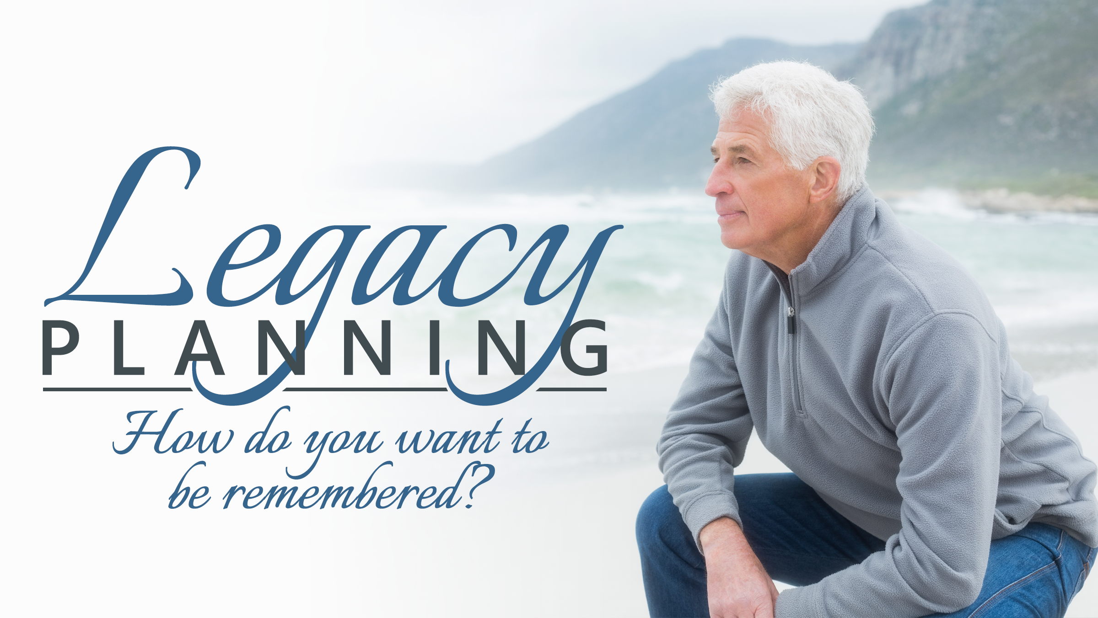
Presented by <<RepresentativeName>>

Slide 2

How do you want to be
remembered?
Notes:
Legacy planning takes estate planning a step further.
When people talk about asset transfer and asset preservation, they usually talk about financial assets. Those aren’t the only ones you have.
Legacy planning recognizes the tangible and intangible assets you possess and their potential to profoundly affect others.
It seeks to preserve your wealth and affirm and sustain the contributions you have made to this world in your life.

Slide 3
Legacy Planning has two aspects...
Conveying your beliefs, values, and heritage.
Preserving tangible and intangible assets.
Notes:
Legacy planning is about conveying your beliefs, values, and heritage to your heirs as well as your wealth.
It tries to direct your accumulated wealth in a way that aligns with your beliefs, values, and outlook on life.
Financially, it aims to turn today’s pennies into tomorrow’s dollars.
Estate planning tools from wills and trusts to stretch IRAs and life insurance may be used in a legacy plan.

Slide 4

You are creating your legacy now.
Legacy planning can help you refine it,
share it, and memorialize it.
Notes:
Good legacy planning conveys your life story, and all that has been valuable about your journey.
It helps you hand down your tangible and intangible assets in the proper context.
It gives you a chance to do things that last beyond your lifetime.
Your life, you wisdom, your experiences – they should not be forgotten.
They should inform and guide your heirs for years to come.

Slide 5
Eventually, your wealth should
serve your legacy.
What could you do today
to make that happen?
Notes:
Eventually, your wealth should serve your legacy. Retirement planning is obviously first, but legacy planning should come second.
You need to establish the vehicles and the routes used for tangible and intangible asset transfer.
Family has many meanings today. Legacy planning is family-oriented, and serves your definition of the word.

Slide 6

The first step in legacy planning?
Looking at where
you are today.
Notes:
The hard work of legacy planning begins with a look at your financial “portrait” today.
Which assets do you need to live, and which ones do you want to leave?
What are the risks to those assets?
How do you want to transfer them?
What will the tax impact be when they transfer?

Slide 7
Good legacy planning is adaptable.
It changes as your needs and circumstances change.
Notes:
No legacy plan should be set in stone. It should be written with the recognition that amendments may be needed someday.
Good legacy planning is not the product of an event, but evolves in an ongoing relationship an estate planning professional.
It may include input from your trusted advisors, your family, and your business partners, as well as representatives of charities or causes meaningful to you.

Slide 8

Legacy planning may have a profound effect on YOU.
It helps you live your life forward.
Notes:
There is an old saying: “You can only understand your life by looking backward, but you can only live it by looking forward.”
Legacy planning helps you live your life forward.
Some people are so burdened by their past that they end up living there. They think about what they should have done.
Legacy planning is about what you can and should do now.
Living your life forward is not only a gift to your loved ones, but also to yourself.

Slide 9

What about the business?
It is never too early to
plan succession.
Notes:
It is never too early to plan business succession.
The earlier you start, the earlier you can plan steps to increase the attractiveness and value of your company. Starting early also affords you more time to explore ways to minimize the tax ramifications of a business sale.
Family business is about family as much as business, and a good succession plan can help to ward off hurt feelings or issues under the surface relating to the sale.

Slide 10

What about your kids
and grandkids?
Wealth may be conveyed
to them in myriad ways.
Notes:
Revocable trusts represent a great route to transferring tangible assets to your heirs. They are terrific estate planning vehicles and key elements in a legacy plan.
Assets not included initially in a trust may be “poured in” later with a pour-over will.
Specialized trusts may be used to address specific legacy planning objectives, and some trusts and stretch IRA strategies can, in theory, extend family wealth for many decades.

Slide 11
The final step in Legacy Planning?
Administration.
Notes:
Once the creator of a legacy plan leaves this world, some very important work must occur – and the trustee of the plan must carry it out.
You need to choose a suitable trustee to execute the provisions of a trust once you pass away.
Ideally, he or she is financially literate, healthy and nearly as invested in the success of the legacy plan as you are.
A good legacy planner steps up appropriately to assist the trustee before and after the passing of the grantor.

Slide 12
Why do some people put off legacy planning?
It makes them think of … the end.
But thinking about your death has a way
of informing your life.
Notes:
Some people procrastinate with regard to legacy planning. It’s only natural; no one likes to dwell on the end.
Thinking about your death, however, has a way of informing your life.
It lets you see it in a context that is profound.
In legacy planning, you can’t start too early; the tragedy is starting too late or not at all.

Slide 13
Questions?
Notes:
I welcome your questions. Ask away!

