Slide 1
RIDING OUT pandemic market volatility
Protecting Your Assets While Positioning Them For Growth

Slide 2
WATCHING FROM THE SIDELINES MAY COST YOU
Notes:
Consider this, according to Franklin Templeton, “On average, for the 12 months following the end of a bear market, a fully invested stock portfolio had an average total return of 37.1%. However, if an investor missed the first six months of the recovery by holding cash, there would have been only 7.6%.”
“Going back to 1930, if an investor missed the S&P 500’s ten best days in each decade, total returns would be just 91%, significantly below the 14,962% returns for investors who held steady through the downturns.” -CNBC, March 7, 2020

Slide 3
Bear markets make people a lot of money, they just don’t know it at the time.
– Shelby Davis
DOLLAR COST AVERAGING

Slide 4
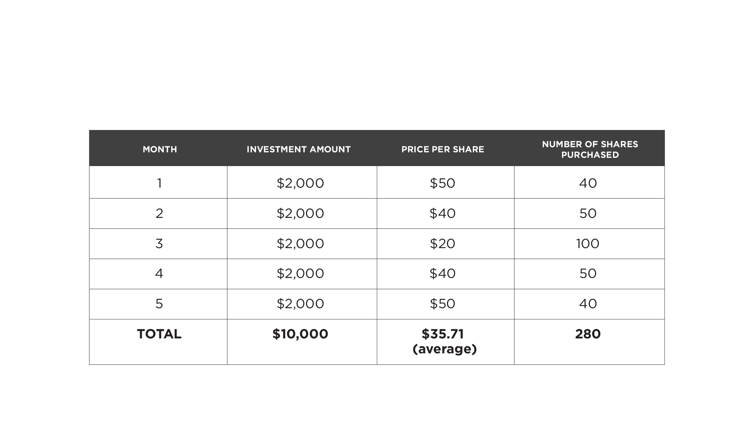
HOW DOLLAR-COST AVERAGING WORKS
Notes:
How Dollar-Cost Averaging Works
Dollar-cost averaging is a simple concept where you invest an equal amount of money into a particular market or asset in regular intervals. It basically allows you buy more shares of an asset when prices are low and fewer shares when prices rise.
Using this strategy essentially guarantees you will pay less per share over a certain period of time by putting your money in a little bit at a time. Let’s take a look at this example from The Motley Fool. An investor decides to put $10,000 into a company over five months by purchasing $2,000 worth of shares on the first of every month. Here’s a chart breaking down the trades:
By using dollar-cost averaging in the midst of a bear market, you will be able to scoop up many shares while prices are low.

Slide 5
AVOID
ACCEPT
MAXIMIZING GROWTH WHILE TRANSFERRING RISK
RISK
REDUCE
TRANSFER
Notes:
If you are older an at or near retirement you can’t afford the same risk as a younger investor. You can’t afford big losses because there may not be enough time to recover losses. With the stock market plummeting, many investors say they now have a different view on risk. This change in mindset, according to analysts, advisers and insurers, will lead people to consider products they previously wouldn’t have touched. Enter annuities. Nearly 30% of investors said they plan to decrease their level of risk as a result of the COVID-19 pandemic, according to a survey commissioned in March by LendingTree’s Magnify Money site. Meanwhile, 32% said the pandemic will have no effect on their future investment decisions. An additional 23% said they planned to keep money out of the stock market, and 21% said they would further diversify their portfolios, according to the survey results. That report included responses from more than 1,000 U.S. investors. Right now the alternative to CD’s and Treasuries is clearly Fixed Indexed Annuities. This will allow the investor to participate in the market rebound without risking loss of principal.

Slide 6
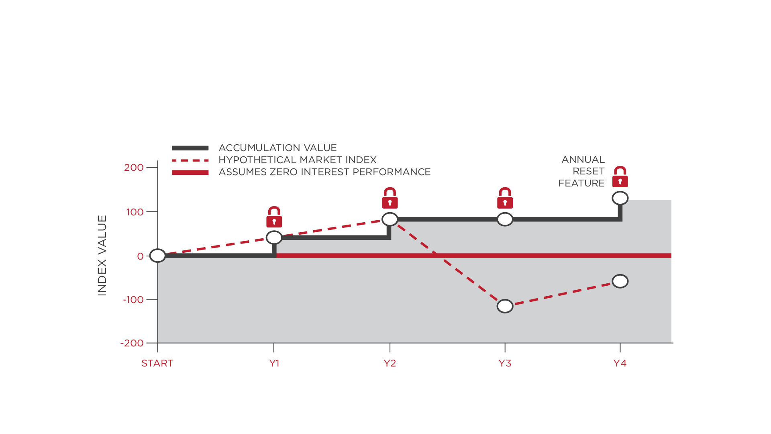
HYPOTHETICALMARKETINDEX
Notes:
An indexed annuity is a contract issued and guaranteed¹ by an insurance company. You invest an amount of money (premium) in return for protection against down markets; the potential for some investment growth, linked to an index (e.g., the S&P 500® Index); and, in some cases, a guaranteed level of lifetime income through optional riders. One element of indexed annuities that is often misunderstood is the calculation of the investment return. To determine how the insurance company calculates the return, it is important to understand how the index is tracked, as well as how much of the index return is credited to you.

Slide 7
TIME FOR A PORTFOLIO CHECKUP?
Notes:
Even the best portfolio can use a little tune-up every so often. You may need to adjust your contribution amounts in order to take advantage of higher retirement plan contribution limits for 2020. The current market volatility may provide you with some excellent tax-loss harvesting opportunities. For those who don’t utilize automatic rebalancing on your accounts, it may be time to reset your investment allocations to match your current goals and time frames.

Slide 8
Never let a good crisis go to waste
– Winston Churchill
The Plan!
The Plan!
Notes:
The coronavirus is scary. Our lives are being changed in ways most of us have never seen before. Despite all this uncertainty and market volatility, eople who have long-term financial plans, own well-diversified portfolios, and are still able to earn an income are much better positioned to ride out this storm. Even among those who have lost their incomes, people who have a financial plan and are prepared for when life happens are going to have a much easier time bouncing back from the COVID-19 lockdown. Franklin Templeton suggested, “When put to the test, you sometimes begin doubting your beliefs and believing your doubts, which can lead to short-term moves that divert you from your long-term goals.”

Slide 9
GET PROFESSIONAL ADVICE!
Notes:
The value of fiduciary financial advice grows exponentially when times are tough. Franklin Templeton asserted, “We believe investors can benefit from the expertise of a financial advisor who can help you define your goals and needs, then identify investments that meet your financial objectives.” In the best of times, your financial planner could seem like an accountability coach, marriage counselor, and money guide all rolled into one. When crap hits the fan, the best financial advisor will help you stay the course and make sure you stay on track for your most important life goals when your instinct may be to bail out and hoard toilet paper and cash under your mattress.

Slide 10
ARE YOU WORKING WITH A FIDUCIARY?
Notes:
KEY TAKEAWAYS
Investment advisers are bound by a fiduciary standard that places their clients' interests ahead of their own.
Brokers work for broker-dealers, whose interests they serve. They follow a suitability standard, which means only that transactions must be suitable for clients' needs.
Broker-dealers can sometimes find themselves in conflict with their clients, who feel that them selling one of their own instruments or adding unnecessary transaction charges breaks the standard, and isn't in the best interest of the client.

Slide 11
SOURCES
https://www.investopedia.com/articles/professionaleducation/11/suitability-fiduciary-standards.asp
https://www.investingdaily.com/54671/dollar-cost-averaging-the-investors-cure-to-the-coronavirus-outbreak/
https://www.forbes.com/sites/davidrae/2020/04/03/coronavirus-stock-market-volatility/#420295747060
https://moneyandmarkets.com/how-does-dollar-cost-averaging-work/

