Slide 1
LOGO

Slide 2
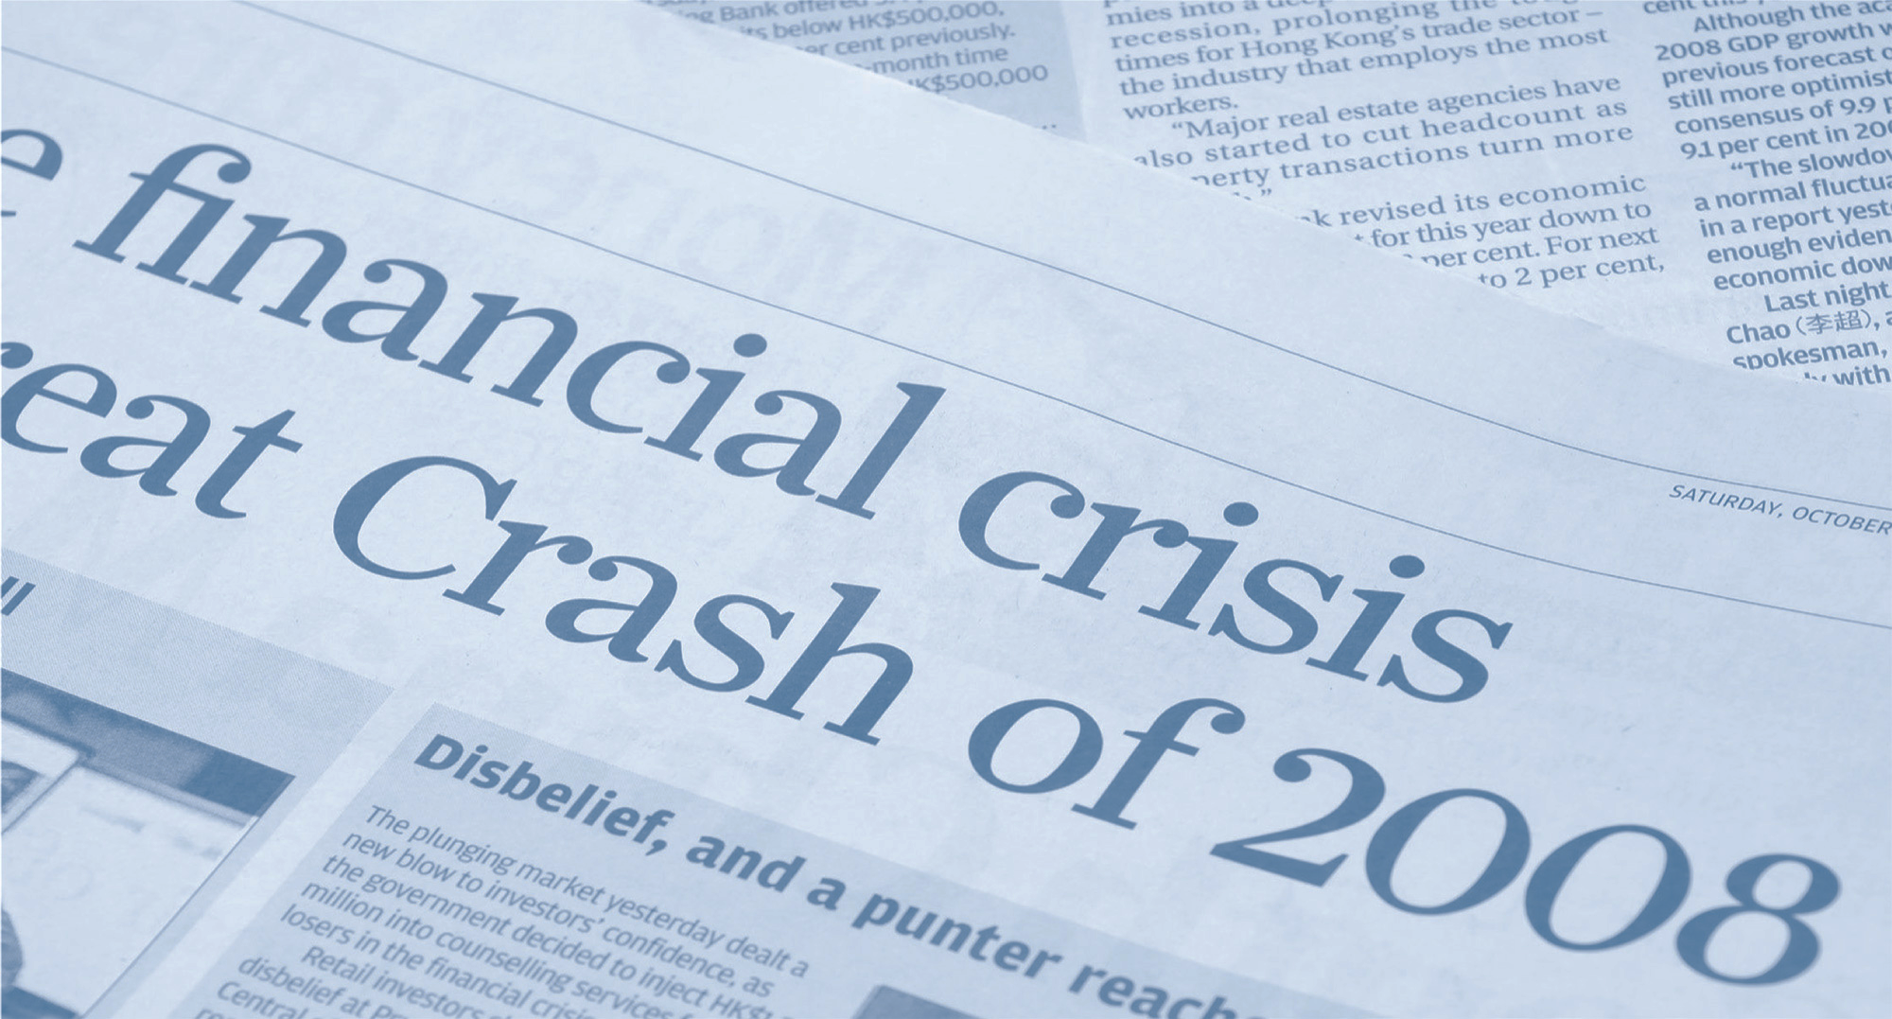
Who could forget?

Slide 3
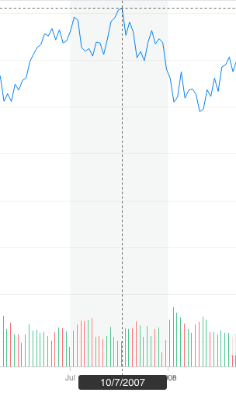
THE CRASH STARTED IN 2007
10/07/07 the DOW was at 13,042
By 3/02/08 it was 11,893
4/27/08 back up to 13,058
Source: Finance.yahoo.com

Slide 4
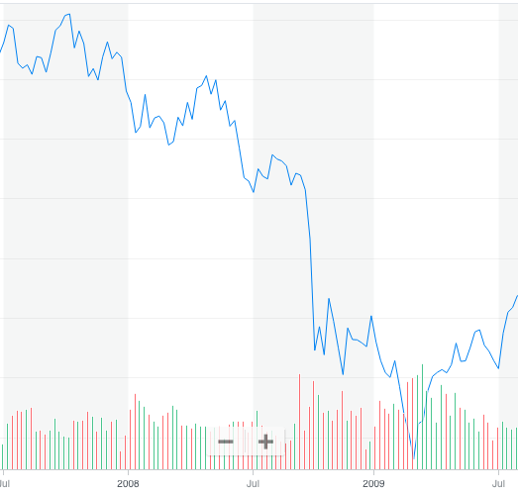
10/07/07 the DOW was at 13,042
By 3/02/08 it was 11,893
4/27/08 back up to 13,058
07/06/08 the DOW was at 11,100
Then it went up to 11,734 on 8/3/2008
3/1/2009 it hit the bottom at 6,626
It took from 2007 to May 2009 to finally hit the bottom.

Slide 5
“What is the right strategy to protect your wealth and grow it when the market rebounds?”

Slide 6
Hold on and wait for the rebound?
Put it in cash to protect yourself from other losses?
Is there a better option?

Slide 7
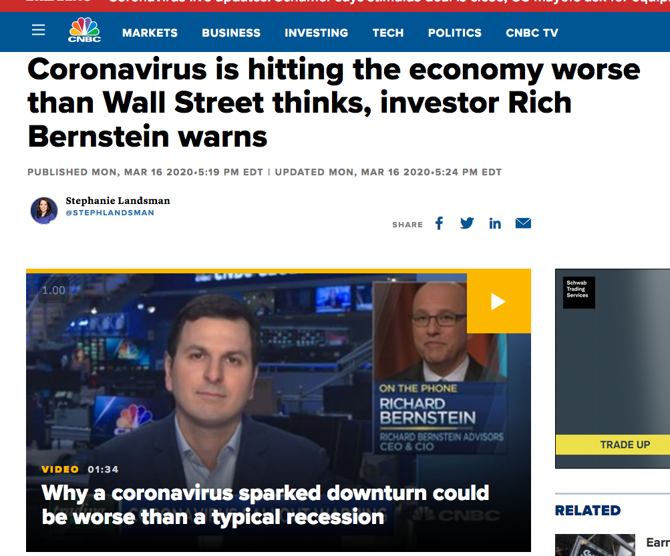
When will the market bottom out and start to recover? How will the shut down impact the economy and the market?
Source: CNBC.com
Source: Foxbusiness.com

Slide 8
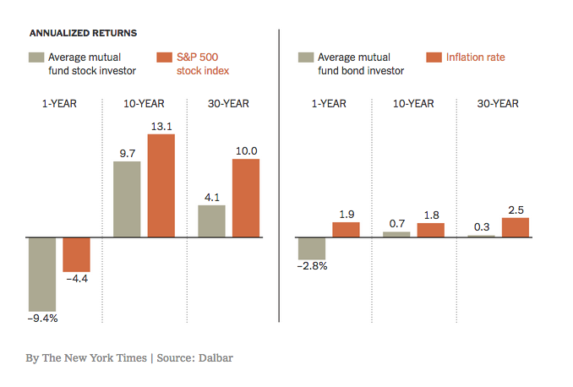
Dalbar Quantitative Analysis of Investor Behavior Report Findings
The average investor over 30 years underperformed the S&P 500 by 5.88 points, earning just 4.1% compared to 10%.

Slide 9
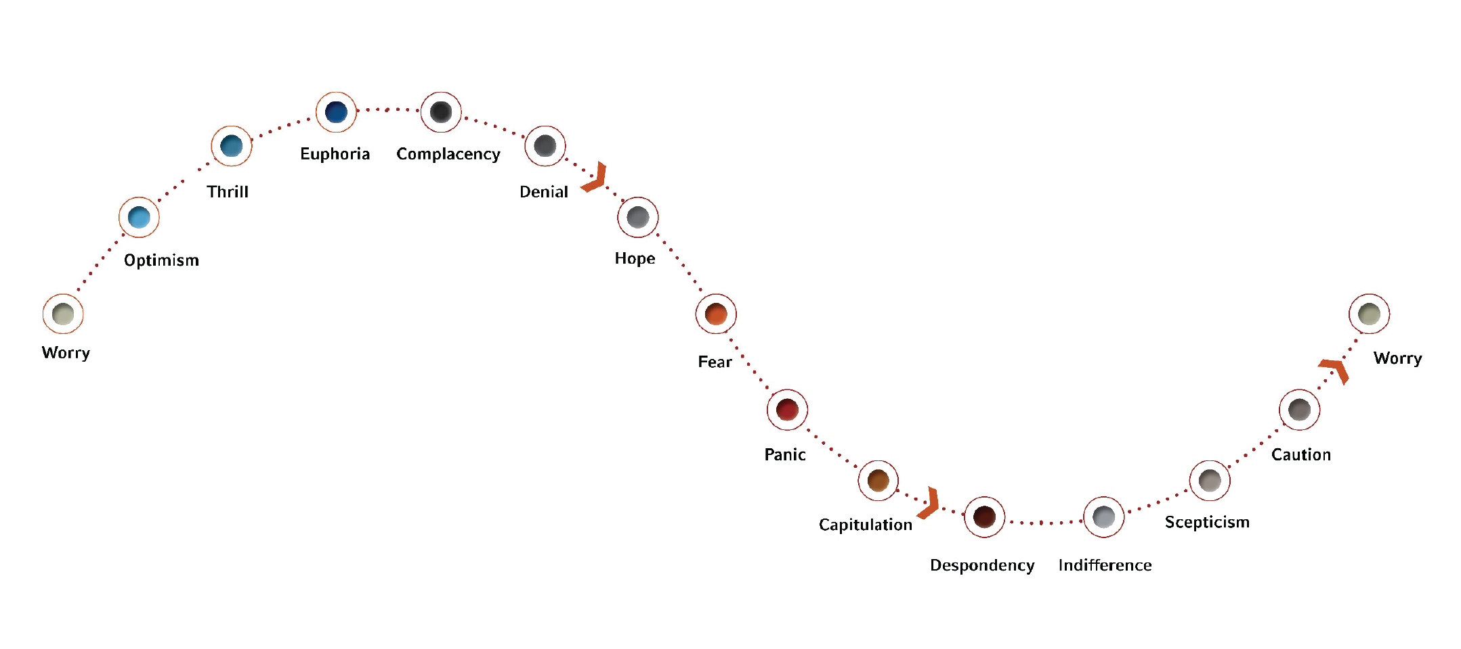
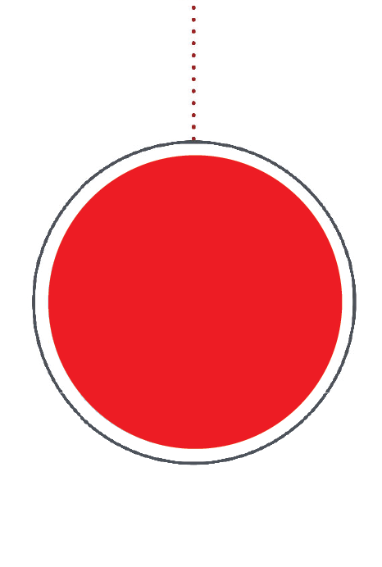
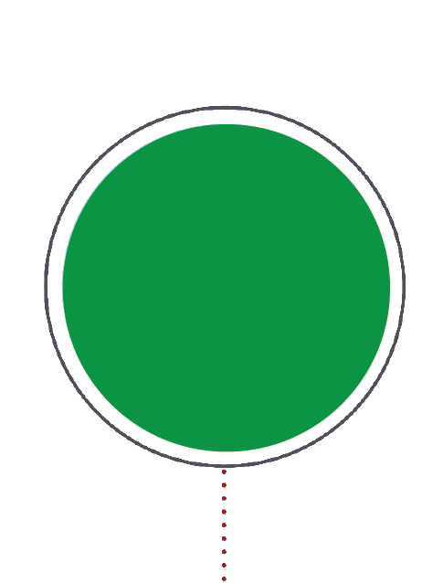
Why do investors do so poorly? The Investor Cycle of Emotion
Wow, I feel great about this investment!
Temporary setback. I’m a long-term investor.
Point of Maximum Financial Opportunity
Point of Maximum Financial Risk
Maybe the markets just aren’t for me.

Slide 10
Dalbar Quantitative Analysis of Investor
“The Dalbar data leads to the inescapable conclusion that most investors, this one included, are bunglers: We panic and exult at the wrong moments, impairing our chances of success.”
https://www.nytimes.com/2019/07/26/your-money/stock-bond-investing.html

Slide 11
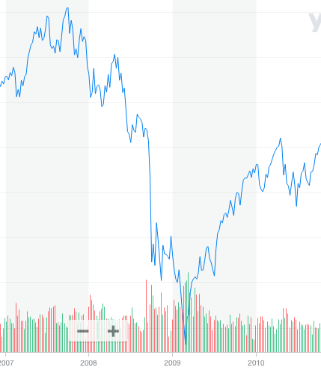
Option 2: What would have happened if you would have sold right here?

Slide 12
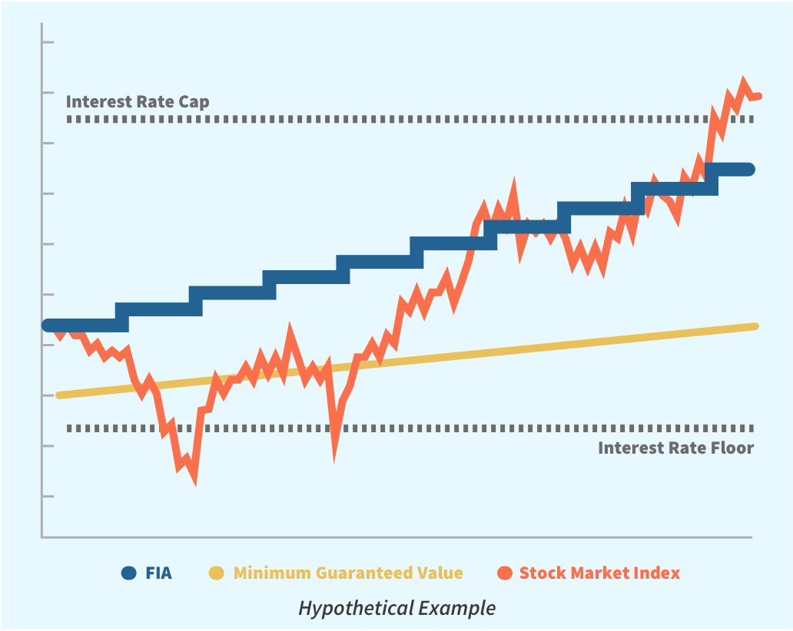
Option 3: Protect Yourself Now, Capture Growth When the Market Rebounds

Slide 13
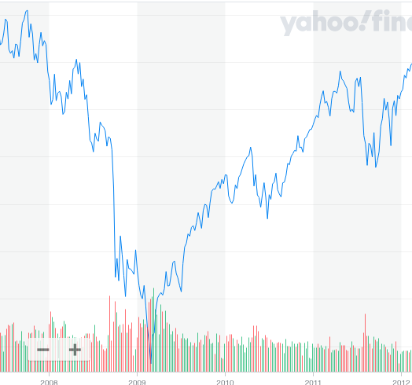
Option 3: Indexing with Cap and Floor

Slide 14
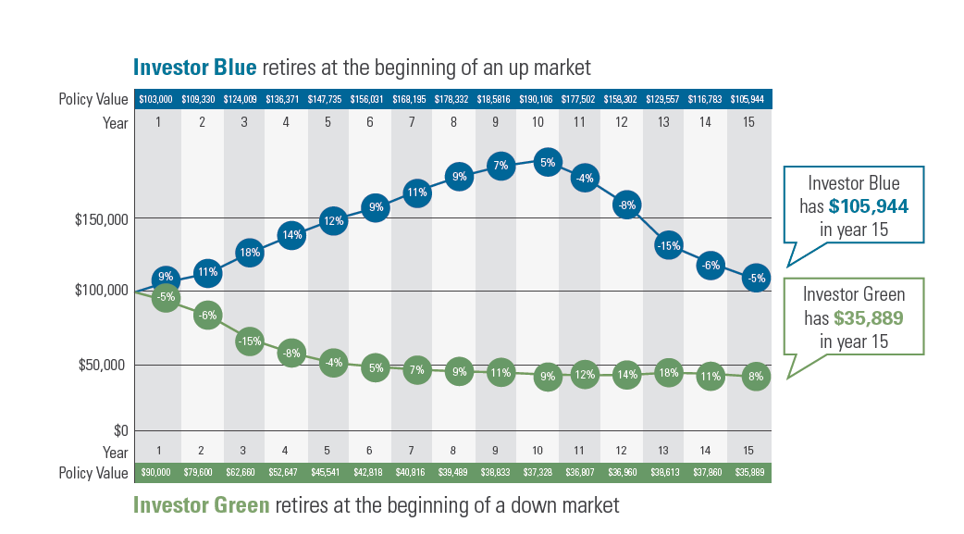

Slide 15
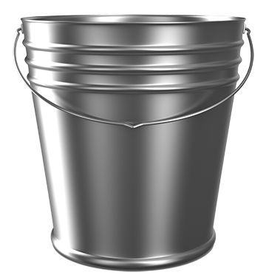
Asset Allocation Analysis
Current and Desired
Risk
& Taxable
Risk
& Tax Free
Secured
&
Taxable
Secured & Tax Free
%
%
%
%
%
%
%
%

Slide 16
No decision is a decision.

Slide 17
Option 1: Hold on for the ride
Option 2: Miss the Rebound
Option 3: Protect yourself now, and capture the rebounds

