Slide 1
KNOW YOUR RISK
Disclosure
Insert Logo

Slide 2
Know Your Risk.
2

Slide 3
Asset A + B Chart
** Source: Guggenheim Life & Annuity TriVysta Fixed Indexed Annuity
3
3

Slide 4
A Better Mousetrap?
40%?
Stocks 60%
4
4

Slide 5
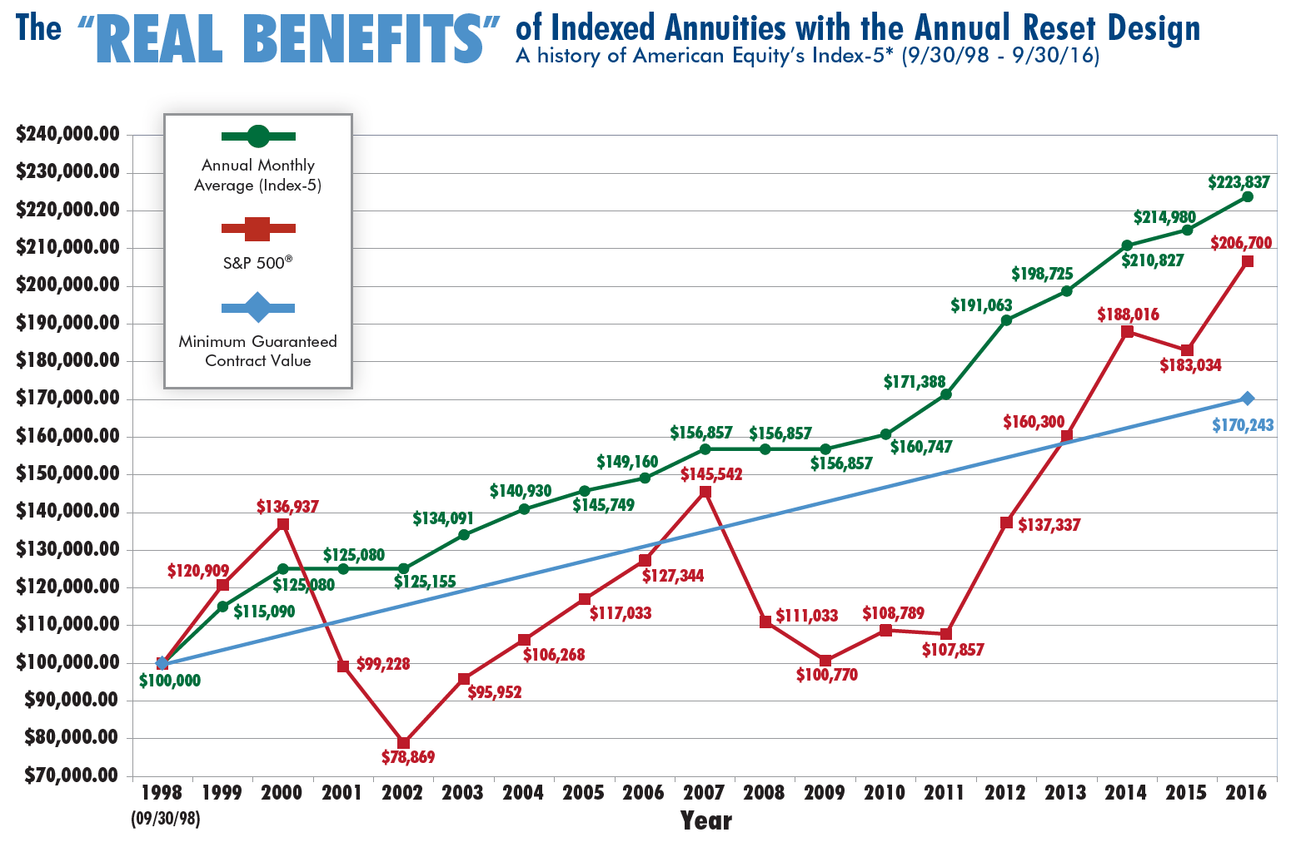
“…an elevator that can only go up*…”
Source: "Money: Master the Game" by Tony Robbins
* Performance numbers for illustrative purposes only. Any presentation of back-tested performance is hypothetical, was compiled after the end of the period advertised, and does not represent decisions made by Clear Creek Financial Management, LLC during the period described.
** Source: American Equity Investment Life Insurance Company.

Slide 6
* The Value portfolio is a proprietary portfolio to our firm. Backtested results assume a static portfolio using historical returns and are net of fees and include reinvested dividends.
Momentum Model link: https://bulwarkcapitalmgmt.com/MomentumModelFactSheet-Feb2021.pdf
Helios Alpha Model link: https://www.spglobal.com/spdji/en/
6
6

Slide 7
* The Value portfolio is a proprietary portfolio to our firm. Backtested results assume a static portfolio using historical returns and are net of fees and include reinvested dividends.
Momentum Model link: https://bulwarkcapitalmgmt.com/MomentumModelFactSheet-Feb2021.pdf
Helios Alpha Model link: https://www.spglobal.com/spdji/en/
7
7

Slide 8
* The Value portfolio is a proprietary portfolio to our firm. Backtested results assume a static portfolio using historical returns and are net of fees and include reinvested dividends.
Momentum Model link: https://bulwarkcapitalmgmt.com/MomentumModelFactSheet-Feb2021.pdf
Helios Alpha Model link: https://www.spglobal.com/spdji/en/
8
8

Slide 9
* The Value portfolio is a proprietary portfolio to our firm. Backtested results assume a static portfolio using historical returns and are net of fees and include reinvested dividends.
Momentum Model link: https://bulwarkcapitalmgmt.com/MomentumModelFactSheet-Feb2021.pdf
Helios Alpha Model link: https://www.spglobal.com/spdji/en/
9
9

Slide 10
Long Term Care Insurance
The importance of being a fiduciary
What is ACTUALLY best for you?
All about OPTIMIZATION
What is it?
Why does it matter?
IUL as a viable option
Why should you be worried?
If a traditional approach is needed, we have specialists we work with.
10

Slide 11
Estate Planning
Not everyone needs an estate plan
2.2m individually or 4.4 joint
What are YOUR assets/liabilities?
"Estate planners are a hammer and you are the nail"

Slide 12
THANK YOU.
Logo
Contact info

