Slide 1

Journey Through the
Retirement Looking Glass
Presented by:
LOGO

Slide 2
Welcome!
Name, Title
About
LOGO

Slide 3


The future ain’t what it used to be.
- Yogi Berra
LOGO

Slide 4
Workshop Objectives
General Information:
Social Security
Medicare
Taxation
Stock Market
Address Misconceptions and Fear
LOGO

Slide 5

401K, Fidelity, Vanguard etc.
RED ZONE RISK
First 5
Prior 5

Slide 6


Length of Retirement
A healthy
65 year-old may expect to live 20 years or longer in retirement:
MEN:
54% living to age 85…
34% to age 90
WOMEN:
64% living to age 85…
45% to age 90
Source: Society of Actuaries 2016

Slide 7
What is Your Vision for Retirement?
LIFE | RESULTS | TOOLS
Health | Income | Social Security
Security | Retirement Income | Pension
Quality | Security | Savings
Travel | Liquidity | 401(k)
Family | Interest | CD/Stock/Bond/MF
Faith | Dividends | Annuity
Golf |  | Real Estate

Slide 8

What is Your Vision for Retirement?

Slide 9

What is Your Vision for Retirement?

Slide 10

What is Your Vision for Retirement?

Slide 11

What is Your Vision for Retirement?

Slide 12
Social Security ─
I am claiming at 62!
Claiming at 62 because of fear could be one of the costliest mistakes you make
Fear Driven
Longevity
Where is the break even?
The power of compounding
Article: Should you buy an annuity from the government?

Slide 13
How Social Security Will Survive
Increased Full Retirement Age (FRA) for future generations
Increased Payroll taxes
Adjusted earnings restrictions
Some combination of above

Slide 14
Future Generations’ Impact
Our economy, markets and Social Security’s solvency are driven by demographics
Fact: Generation Y projected to surpass the Baby Boomers by 2019
Born 1981-1996, Gen Y will be the largest generation in our country’s history
They will be paying into Social Security

Slide 15
Future Generations’ Impact

Slide 16
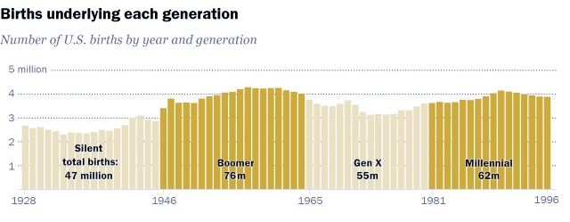
Future Generations’ Impact
Source: US Department of Health and Human Services National Center for Health Statistics.
THE PEW RESEARCH CENTER

Slide 17
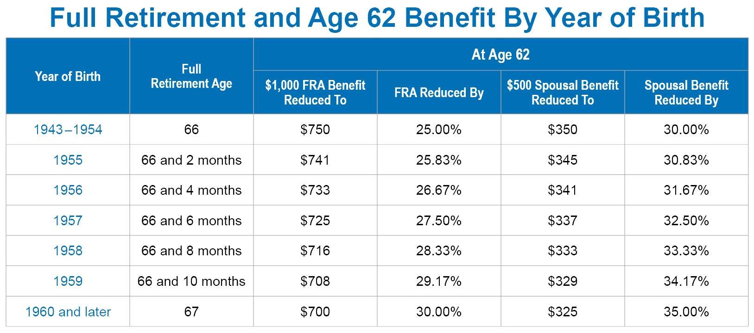
Claiming Benefits Early vs Full Retirement Age
Full Retirement and Age 62 Benefit by Year of Birth

Slide 18
Earnings Restrictions
Reduction in benefits
Potential ADDITIONAL reduction in benefits if you are still working
Not the boost to your savings that you may have thought
As of 2018, when taking benefits early….
$1 of benefits is deducted from your Social Security benefit
for every $2 of earnings you have OVER $17,040
Source: https://www.ssa.gov/planners/retire/whileworking.html (accessed March 12, 2018). This is provided for informational purposes only and is not intended to provide specific tax or legal advice or serve as the basis for any financial decisions. Be sure to speak with qualified professionals before making any decision about your personal situation.

Slide 19
Key Factors in Retirement
LONGEVITY
INFLATION
TAXATION
If your current plan doesn’t account for longevity, inflation and taxes ─ YOU DON’T HAVE A PLAN.

Slide 20
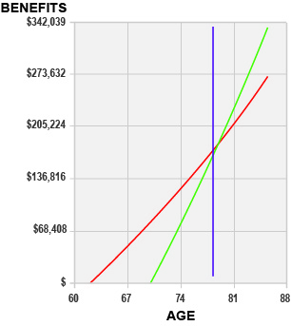
Impact of Living Longer
Cumulative Benefits
$342,039
Early Strategy
Delayed Strategy
Delayed Strategy becomes better than Early Strategy at age 78 years, 11 months
2% inflation factor
$273,632
$205,224
$136,816
$68,408
$
60
67
74
81
88
This hypothetical example is for illustrative purposes only and should not be deemed a representation of past or future results and is no guarantee of future performance.
AGE

Slide 21
Comparison
Living to age 75:
Start at 62:
$137,423
$36,984 More
Start at 70:
$100,439
Living to age 85:
Start at 62: $269,953
$63,744 More
Start at 70: $333,697
Living to age 95:
Start at 62: $431,456
$186,485 More
Start at 70: $617,941
This hypothetical example is for illustrative purposes only and should not be deemed a representation of past of future results and is no guarantee of future performance. Information is not intended to provide specific legal or tax advice. You are encouraged to consult with the Social Security Administration or your tax or legal professional for guidance on your individual situation.

Slide 22
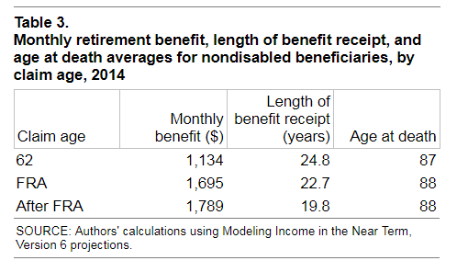
Impact of Claiming Early Based On Average Lifespans
The average death age for those who claim at 62 is only 1 year lower than those who claim at their FRA or later.
Yet early claimants receive $500 or less per month compared to those who claimed at FRA or later.
Source: “Incentivizing Delayed Claiming of Social Security Retirement Benefits Before Reaching the Full Retirement Age.” Melissa A. Z. Knoll and Anya Olsen, Social Security Bulletin, Vol. 74, No. 4, 2014. https://www.ssa.gov/policy/docs/ssb/v74n4/v74n4p21.html (accessed March 12, 2018).

Slide 23
How to Claim Benefits
File Early
File Late
File at Full Retirement Age
File on a Spouse’s record
File on Divorced Spouse’s record (if married for 10 years)
File on Deceased Spouse record
All sorts of combinations
What makes sense for you?

Slide 24
On The Return
 | 40k IRA 20k Social Security | 20k IRA 40k Social Security
Taxable Social Security
Taxable Other income
Total Taxable Income
Minus Standard Deduction and Personal Exemptions
Net Taxable Income
Total Federal Income Tax
$11,100
$4,000
$40,000
$20,000
$51,100
$24,000
$26,600
$26,600
$24,500
$0
$2,559
$0
Table assumes Married Filing Jointly, 2018 tax brackets, Standard Deduction, plus additional deductions for over 65.
Notes:
When we bring those numbers onto the tax return, we see it a bit more clearly. The 40k IRA/20k Social Security blend results in $2,559 of Federal Income Tax. The opposite Blend creates no federal income tax at all!

Slide 25
Taxes on Social Security Benefits
Combined Income Thresholds
Taxable Portion of Benefits | Single Filer | Married Joint filer
50% | $25,000-$34,000 | $32,000-$44,000
85% | Over $34,000 | Over $44,000
“Combined Income” formula used by the IRS: MAGI (Modified adjusted gross income) = Adjusted Gross Income + Tax-exempt Interest + 50% SS Benefit

Slide 26
Taxes in Retirement
Sources of Income That Are Taxed:
ALL sources with one exception ─ Roth Income
Required Minimum Distributions (RMDs)
  What are RMDs and will it affect MAGI?
  Required from Qualified accounts – 401(k), 457, IRA,
  Lump Sum Pensions
  Could cause higher taxation on income
  Could also increase Medicare Premiums due to means testing –
  Roth conversions could affect this as well

Slide 27
Medicare Excess Premiums – Married, Filing Jointly 2018
Income | Part B (Annual) | Part D (Annual)
0-$170,000 | $1,608.00 | Plan Cost Only
$170,001 – $214,000 | $2,250.00 | Plan + $156.00
$214,001 - $267,000 | $3,214.80 | Plan + $403.20
$267,000 - $320,000 | $4,179.60 | Plan + $650.40
$320,000+ | $5,143.20 | Plan + $897.60
Premiums for 2018 are based on 2016 income levels
Notes:
So now we’ve covered the most common ways things that create both confusion and opportunity around tax in retirement. These last few are things that impact higher income people primarily, but could impact you in a year you do a Roth conversion or have a large, unusual purchase. Medicare is now means tested, and these thresholds include your full Social Security benefit. If you fall over the threshold, you end up paying an extra Medicare part B and part D premium. In the scope of your total tax bill, its probably not much, but its not insignificant either. These premiums are based on your income from two years ago, so its worth paying attention to the thresholds as you consider how much to take from various accounts.

Slide 28
Delaying Social Security Benefits
More money in the long run
It is guaranteed for life
If married and one spouse passes, you keep the higher benefit
What if I want to retire before 70?
How do I bridge the gap?

Slide 29

Effective Marginal Tax Rates
How much of your last dollar do you actually lose to Uncle Sam?
Notes:
The complications we’ve just outlined should highlight one major point. Over time, when government has needed new tax revenues, the method has not been to change rates or brackets evenly across all taxpayers. Instead, it has been to introduce phase-outs of deductions or exemptions, or begin to include income that was previously not taxable, like Social Security Benefits. The result is a tax system in which the most important number isn’t necessarily the tax bracket you land in, but instead is the Effective Marginal Rate. In other words – How much of your last dollar did you actually lose to Federal Income Tax?

Slide 30
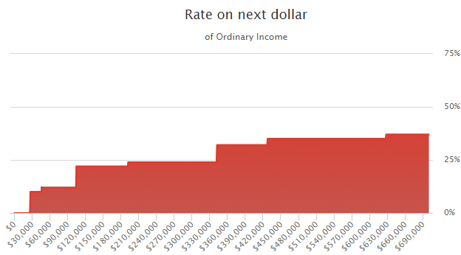
Married, Filing Jointly – 2018 Ordinary Income Tax Map
35%
37%
32%
22%
24%
12%
10%
Source: Tax Clarity Software Output for John and Jane.
Notes:
Let’s revisit the tax map. Remember, as you increase ordinary income from left to right across the bottom, you can see the rate that should intuitively be applied to the next dollar.

Slide 31
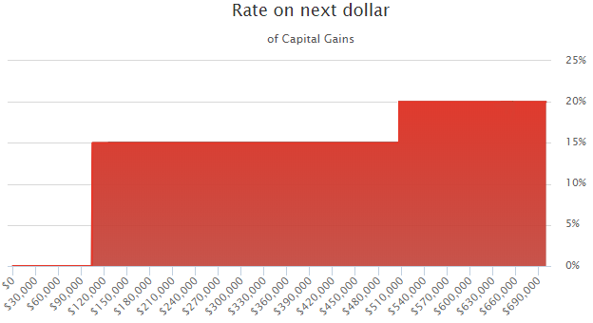
MFJ – Long Term Gain and Dividend – 2018
20%
15%
0%
Source: Tax Clarity Software Output for John and Jane.
Notes:
And here is the tax map for capital gains…

Slide 32
Case Study – The Real Tax System
John and Jane – Married Filing Jointly – 65+
$60,000 combined Social Security income
$15,000 of Net Long Term Capital Gains
$45,000 Required Minimum Distributions
Notes:
Let’s do a quick case study to illustrate the idea of Effective Marginal Rates. We have John and Jane. They are Married Filing jointly and both over 65. They have $60k of combined Social Security income, $15k of Long Term Capital Gain this year and a $40,000 IRA withdrawal.

Slide 33
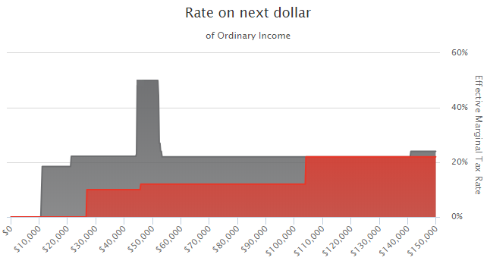
The “Real” Tax System: Ordinary Income
49.95%
22.2%
22%
24%
18.5%
Source: Tax Clarity Software Output for John and Jane.
Notes:
Here’s their Tax Map. You can see that once they harvest a little over $10k in ordinary income, they begin to experience an 18.5% Effective Marginal tax rate. That is the point that their ordinary income plus capital gain drags enough Social Security into the calculation to begin making every additional dollar withdrawn from the IRA taxable at 10% and each additional dollar over that drags another 85 cents of Social Security into the mix, creating an Effective Marginal Rate of 18.5%. You can see this couple never really experiences the 10% or 12% brackets. They go from 18.5 to 22.2 to almost 50% before dropping down to back into the regular brackets.

Slide 34
49.95% - How did that happen?
What Intuitively Should Happen:
$1,000 additional IRA Withdrawal 12% Bracket $120.00
What Actually Happens:
$1,000 additional IRA Withdrawal 12% Bracket $120.00
Causes $850 Taxable SS 12% Bracket $102.00
Causes $1,850 Capital Gains to be taxable 15% Bracket $277.50
Total Additional Tax Burden on $1,000 withdrawal: $499.50
Example used as illustration and is not indicative of any particular situation. Actual results will vary.
Notes:
If you are saying “whoa – wait a minute that spike occurred at the 12% bracket – how did that happen?” you are not alone.
Intuitively, this is a couple in the 12% bracket for ordinary income. You would expect a $1,000 additional withdrawal to create 12% of tax - $120.
But here’s what actually happened. The $1000 withdrawal did get taxed at 12%, - $120. But then it caused $850 of Social Security Benefits to become taxable, adding $102 to the tax bill, which then together caused $1,850 of Capital Gains that would have come through at 0% to become taxable, resulting in another $277.50 in Federal Income Tax. In short, on that $1,000, the couple lost 49.95% to Federal income tax.

Slide 35
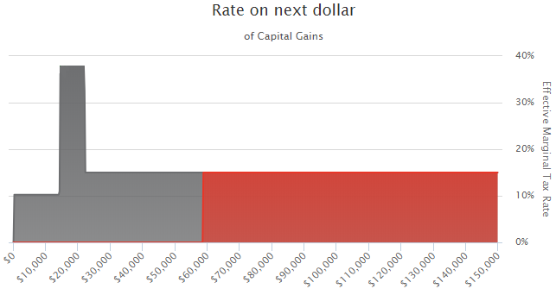
The “Real” Tax System: Capital Gains
38%
15%
10.3%
Example used as illustration, is not indicative of any particular situation, and is not intended as advice.
Actual results will vary. Please consult with a financial professional before taking action.
Notes:
You have a very similar effect with Capital Gains. If the couple were choosing whether or not to sell a stock with $25k of gains this year, they would certainly want to know that on a portion of that sale they would actually lose to federal income tax. Maybe it makes sense to only sell part of the position this year, avoiding the spike.

Slide 36
Tools for Tax Control
Diversify among account types
  IRA
  Roth including Roth Conversions
  Non-Qualified (taxable)
Use Tax-Deferred products where appropriate
Properly blend withdrawals from different accounts
Consider which assets should be held in which account type
Notes:
The fact is that there are a lot of ways to control taxes and to plan in advance to create tax efficient retirements. Diversifying among different account types that have different tax treatment, using tax deferred products where appropriate, blending withdrawals from different account types, rather than simply harvesting in sequential order, and paying close attention to which types of investments you hold in which account can all make a difference in the tax efficiency of your retirement income.

Slide 37
Size Up Current Situation
How do you intend to spend in retirement?
How will you support your desired lifestyle?
Should I have all of the money that I will need already saved?

Slide 38
Choose a Distribution Method
Sounds pretty easy… but is it???
Understand Distribution Rules
Delay Social Security
What do I spend first?
Taxable before tax-deferred?
Winners before losers?
Do you want to leave highly appreciated assets to heirs?

Slide 39

“The Devil is in the Details”

Slide 40
FEAR of the Market
Volatility
Inflation
How to invest in retirement
Where to invest
Sequence of return risk
Liquidity
When markets are high - people are terrified
When markets are low -people feel confident
Media - biased and unbiased research
If you lock fear into your mind - you will miss the entire growth curve

Slide 41
Understanding the Market
155 million housing units
310 million people
25 million housing units short
Economy is about to explode based on demographics

Slide 42
How Long Would a Retirement Portfolio Last?
It depends…
Stay put
Lump-sum distribution
Systematic withdrawals
Lifetime annuity

Slide 43
What we NEED to address
Volatility
Inflation
Distributions
How much your lifestyle costs
Biased and Unbiased Information

Slide 44

Income Planning:
Creating Your Own Pension
“Retirement income
should never be risked.”
“The key is having
safe income for your
fixed expenses.”
- Alicia Munnell Harvard Ph.D.
Alicia Munnell Ph.D.,
Harvard University
Director of the Center for Retirement Research at Boston College

Slide 45
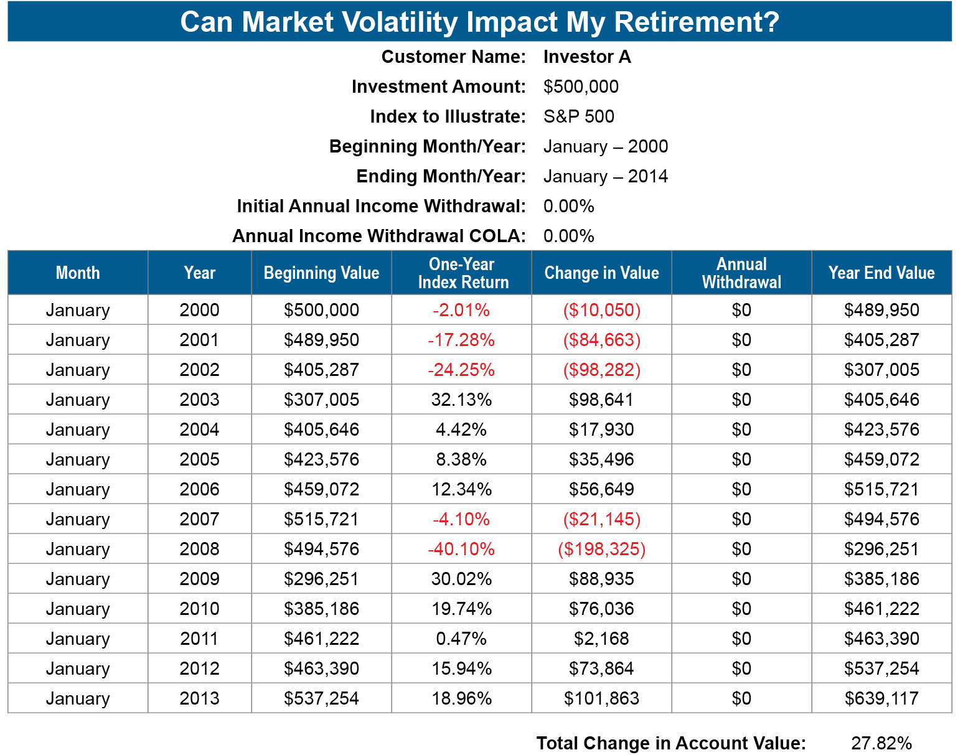
The purpose of this illustration is to demonstrate the potential risks of depleting an account when annual withdrawals are combined with market volatility. To demonstrate this potential risk, the illustration shows hypothetical historical results of an account invested in a broad stock market index. The index values used for the calculations are month-end closing values that are adjusted for dividends and splits. Calculations assume deferral of taxes. The Standard & Poor’s 500 (S&P 500) is an unmanaged group of securities considered to be representative of the stock market in general. The Dow Jones Industrial Average (DJIA) is a price-weighted average of 30 significant stocks traded on the New York Stock Exchange.

Slide 46
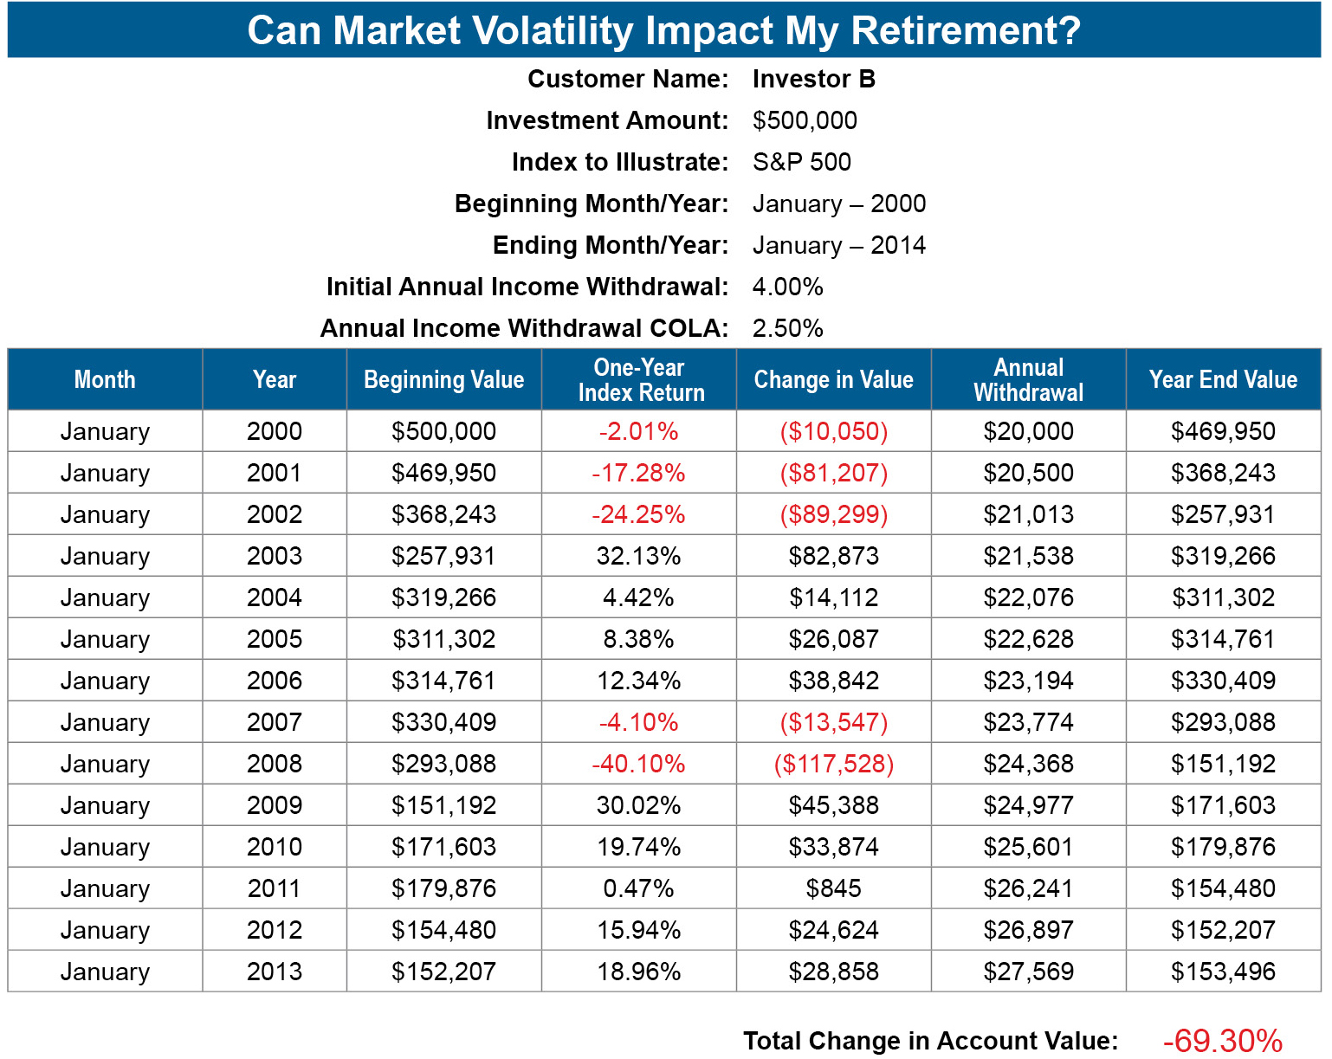
The purpose of this illustration is to demonstrate the potential risks of depleting an account when annual withdrawals are combined with market volatility. To demonstrate this potential risk, the illustration shows hypothetical historical results of an account invested in a broad stock market index. The index values used for the calculations are month-end closing values that are adjusted for dividends and splits. Calculations assume deferral of taxes. The Standard & Poor’s 500 (S&P 500) is an unmanaged group of securities considered to be representative of the stock market in general. The Dow Jones Industrial Average (DJIA) is a price-weighted average of 30 significant stocks traded on the New York Stock Exchange.

Slide 47

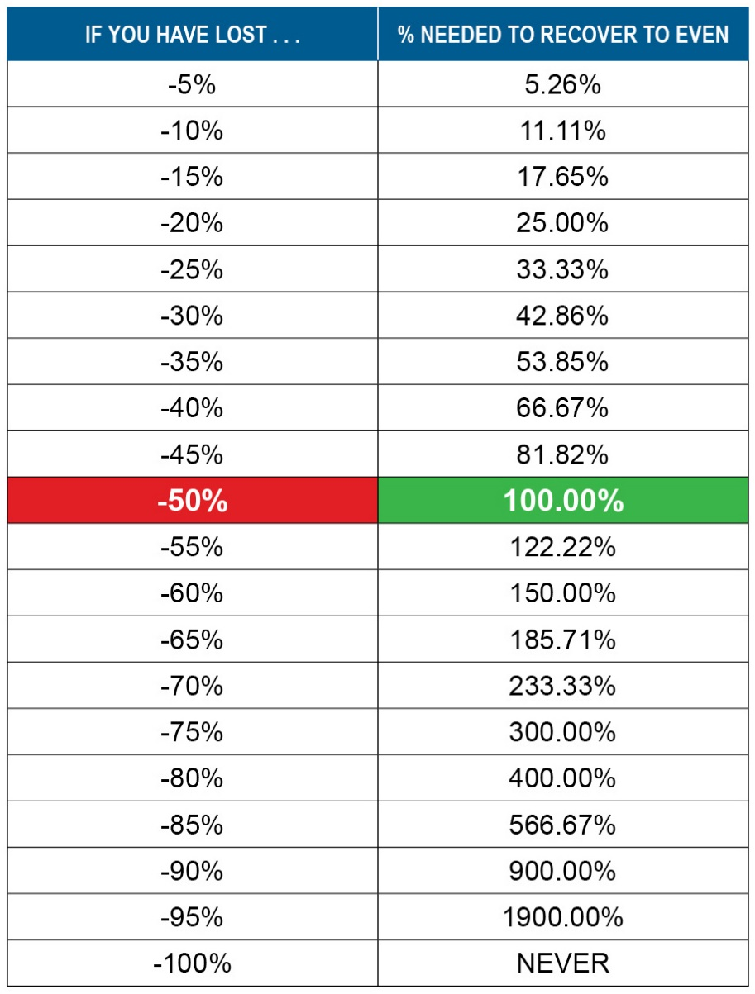
How much will it take for YOUR money to come back when you have a loss?

Slide 48
Investment Strategy
Shift from Growth to Income assets
Does tax-exempt investing make sense for you
What is an appropriate asset allocation
Guaranteed income assets
Long-Term Care
What is available
Prepare for unexpected

Slide 49

Investing for a Long Retirement
Hypothetical $850,000 portfolio divided into 3 parts
Second fixed income vehicle depleted after 10 years
$206,026 used to invest
in a new fixed-income vehicle after 5 years
$850,000 after 10 years
Depleted after 5 years
$206,026
$169,338
$474,636
Fixed-income vehicle @3%, withdrawing $45,000 annual income for 5 years ($32,400 after taxes)
Conservative Investments @4%
Growth
Investments @6%
Example used as illustration, is not indicative of any particular situation, and is not intended as advice. Fees and charges are not considered.
Actual results will vary. Please consult with a financial professional before taking action.

Slide 50
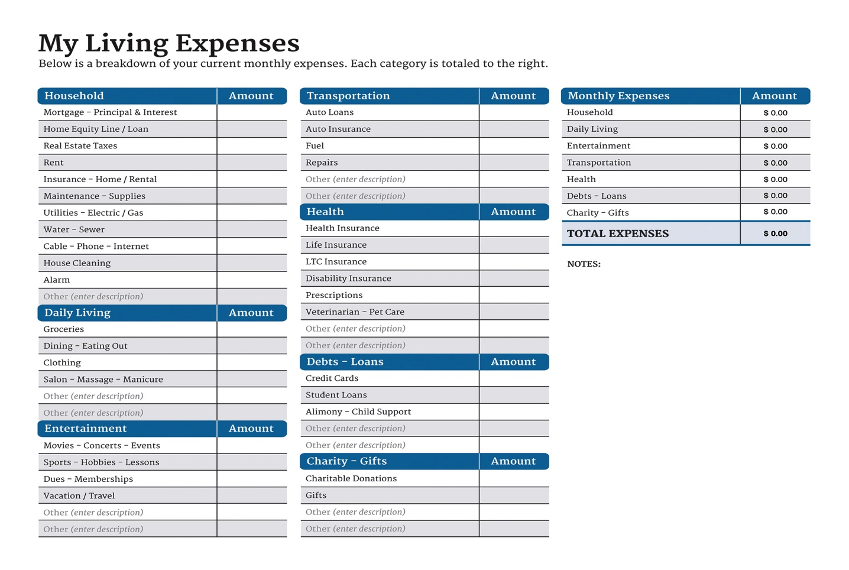
Figuring Out Your Net Cash Flow
Can you account for where your money goes?

Slide 51
Next Steps
Figure out your Net Cash Flow
Total Monthly Income - Total monthly expenses = discretionary income
How much of the discretionary income are you saving?
Figure out your Net Worth
Total Assets - Total Liabilities = Net Worth
Set a goal – 5 years, 10 Years
Estate Plan – durable documents, beneficiaries

Slide 52

Tools for Tax Control
What Have
We Learned?
Diversify among Account Types
  IRA
  Roth including Roth Conversions
  Non-Qualified (Taxable)
Use Tax Deferred Products where appropriate
Properly Blend Withdrawals from different accounts
Consider which assets should be held in which account type

Slide 53
What Is Your Vision for Retirement?
What Have We Learned?
LIFE | RESULTS | TOOLS
Health | Income | Social Security
Security | Retirement Income | Pension
Quality | Security | Savings
Travel | Liquidity | 401(k)
Family | Interest | CD/Stock/Bond/MF
Faith | Dividends | Annuity
Golf |  | Real Estate

Slide 54

Thank You!
Name
Email:
Phone:
Address:

