Slide 1

TITLE
LOGO
//
DISCLOSURE
Notes:
To use this title animation slide with a new image simply 1) move the top semi-transparent shape to the side, 2) delete placeholder image,
3) click on the picture icon to add a new picture, 4) Move semi-transparent shape back to original position, 5) Update text on slide.

Slide 2

From the Advisor
Introduction
Why we do this
Background
Notes:
To use this title animation slide with a new image simply 1) move the top semi-transparent shape to the side, 2) delete placeholder image,
3) click on the picture icon to add a new picture, 4) Move semi-transparent shape back to original position, 5) Update text on slide.

Slide 3

Our Mission
Insert Company Mission
Notes:
To use this title animation slide with a new image simply 1) move the top semi-transparent shape to the side, 2) delete placeholder image,
3) click on the picture icon to add a new picture, 4) Move semi-transparent shape back to original position, 5) Update text on slide.

Slide 4
From the Advisor
Insert Company Info
Notes:
To use this title animation slide with a new image simply 1) move the top semi-transparent shape to the side, 2) delete placeholder image,
3) click on the picture icon to add a new picture, 4) Move semi-transparent shape back to original position, 5) Update text on slide.

Slide 5
Are you working with an Advisor who acts as a Fiduciary?
If not, you should be.
Brokers work for broker-dealers, whose interests they serve. They follow a suitability standard, which means only that transactions must be suitable for clients' needs, NOT THE ACTUAL INVESTMENT ITSELF. (Example bond client)
Advisers and investment brokers, who work for broker-dealers, both tailor their investment advice to individuals and institutional clients. However, they are not governed by the same standards. Investment advisers (RIA) work directly for clients and must place clients' interests ahead of their own, according to the Investment Advisers Act of 1940.
Investment advisers (RIA) are bound by a fiduciary standard that places their clients’ best interests ahead of their own.
(if you don’t work with us, we highly recommend working with an RIA)
*Source: Investopedia

Slide 6
What Does It All Add Up To?
So, lets talk about the economy!
The effect of Covid on our country
  Short term
  Long Term
  PPP Funding

Slide 7

What’s a Billion Dollars?
Billion Seconds Ago: Ronald Reagan was President (1988)
Billion Minutes Ago:
Jesus walked the Sea of Galilee
Billion Hours Ago:
Man lived in caves
The current US Budget Debt is 30 Trillion dollars and climbing every day! What’s more important is the current US Budget Deficit (this is the amount of interest that is owed monthly to service the debt) is a much scarier number. The budget deficit in 2021 was nearly $2.1 Trillion dollars!
U.S. Senator Rand Paul (R-KY)
December 22, 2020

Slide 8
U.S. Net Interest Expense
Net Interest
In the budget, net outlays for interest primarily encompass the government’s interest payments on federal debt, offset by interest income that the government receives.
In CBO’s projections, net outlays for interest in 2020 edge up to $382 billion, from $376 billion in 2019. Those outlays more than double over the next 10 years, reaching $819 billion in 2030. As a result, under current law, net outlays for interest are projected to grow from 1.7 percent of GDP in 2020 to 2.6 percent in 2030.
819 Billion
/ $15,000
= 54,600,000 Taxpayers!
Copyright 2020 © Live.2.100, Inc.
Notes:
“Net Interest Expense” <Click> associated with the National Debt (money owed to the Public).
Our Net Interest Expense is the difference between what the US earns on its investments and the interest it pays on its debt; a.k.a., the “Net Loss”
Each bullet is a click:
In 2020, we paid $382 Billion in interest (actual payments) on the Public Debt
In 2030, just 10 years from now the Net Loss will exceed $819 Billion Dollars! <Click>
On average, taxpayers pay the federal government about $15,000 per year <Click>
That means it will take 54 Million, 600 Thousand taxpayers to pay the interest only debt in 2030! <Click>
Let me illustrate how many people that is <Click>

Slide 9
Tax Increases Are a Mathematical Certainty
Is our Federal Deficit a concern?
Think of this: AT&T Stadium home of the Dallas Cowboys
  Capacity is 100,000 people
  At max capacity, if each person in the stadium paid $15,000 toward the $850 billion dollars in interest currently owed on the Federal Debt, it would take 540 filled AT&T stadium just to pay 2030’s Net Interest Expense

Slide 10
How Do We Prepare for an Increasing Tax Rate Environment?
Move investments into tax friendly investments and plan accordingly
  Municipal Bonds
  Life Insurance Policies
  Efficient IRA Strategies that create income
  Tax Friendly Estate Planning techniques

Slide 11
Municipal Bonds
  We like Fed/State tax free municipal bonds for our clients living within the state they are issued.
  Municipal bonds are a great way to diversify a portfolio and receive income in a tax-friendly manner
  We typically recommend bond funds (as opposed to individual bonds) to our clients because they are more liquid. Bond funds also offer more diversification in a portfolio which offers a second layer of protection and minimizes risk.
  Challenges: due to the recent (low) interest rate environment, yields have been low.
  Liquidity: individual bond holdings sometime have long durations which limits investment options should interest rates or other investment opportunities arise.

Slide 12
Here’s What it Looks Like
Tax Efficient Strategy
Steve is a 56 year old looking to retire in the next 2 years with a pension.
He, fortunately, has a very good pension that will pay him nearly $175,000 annually. He and his wife (no kids) currently live on $100,000 per year, leaving them with a surplus after taxes of $22,500. He is concerned about inflation later in life.
Here’s what we proposed: Take a portion of the $22,500 and purchase life insurance designed to take tax-free withdrawals later if needed.

Slide 13
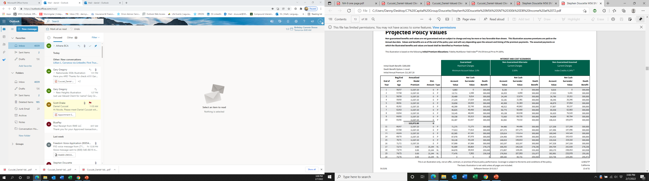
Projected Policy Values

Slide 14
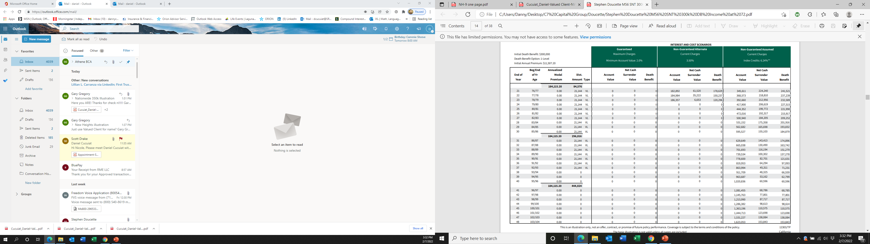

Slide 15
Here’s how they work
What if I am concerned about market volatility and I need consistent income?
Fixed Indexed Annuities
  Benefits: low fees, guaranteed against market downturns, create reliable income streams, great for qualified retirement accounts
  Companies that offer them: We only work with A rated carriers when Advising our clients
  Downside: they are NOT liquid, you will only enjoy partial upside of the index they are tied to

Slide 16
Here’s how it works
Actual Client Case Study
Linda has an IRA worth $350,000 that she has not touched and this year she turned 72 years old. The IRS now requires that she takes minimum distributions (RMD) from her IRA of approximately 3.8% and every year going forward the IRS will force her to withdraw a higher percentage. Linda would like the additional income of $13,300, but is there a better option?
Here’s what we did: Once the IRS forces you to start withdrawing principal and interest from your IRA, the IRA basically became an annuity…only without the guarantees and benefit an annuity offers. So, the question becomes, would you rather have an inconsistent amount of income starting at $13,300 per year until your IRA is depleted or $22,680 per year guaranteed for life with principal protection and other features such as Chronic Illness Protection?

Slide 17
Proposed
Annuity IRA
$378,000
(Including income bonus)
Proposed
Annuity IRA
$385,000
(Including income bonus)
Present
IRA $350,000
Annual RMD
$13,300 Paid Until
Account Depleted
Annual Income $23,522 Paid and Guaranteed
for Life

Slide 18
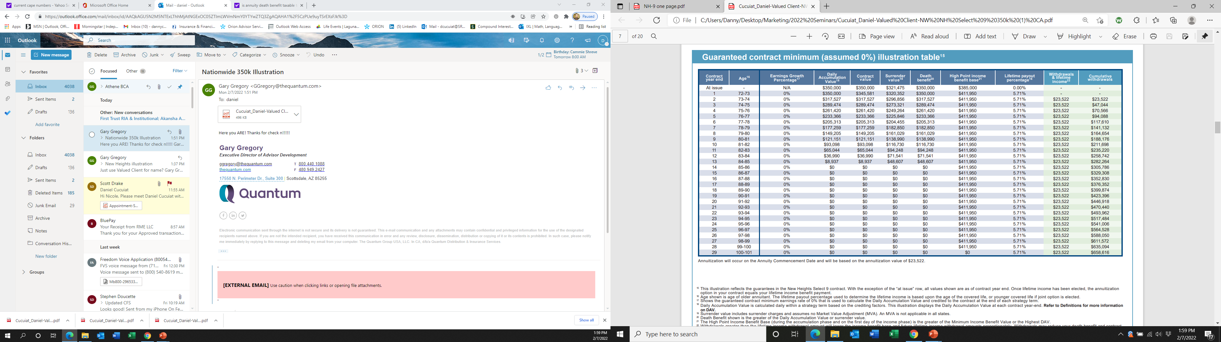

Slide 19
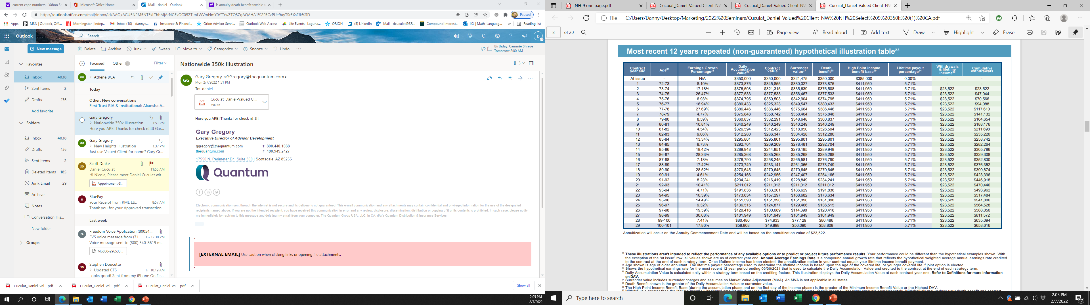

Slide 20
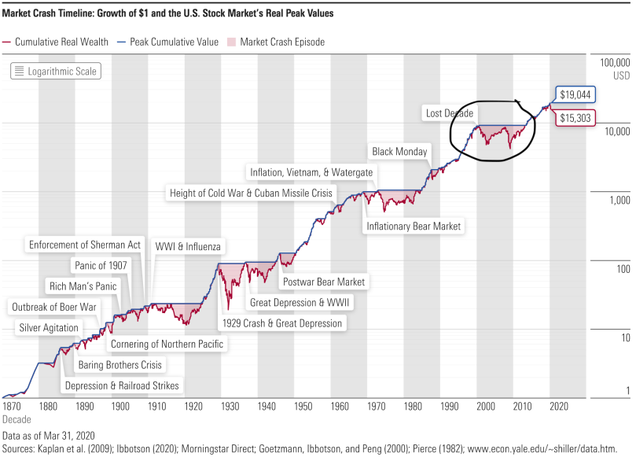
Market Crash Timeline: Growth of $1 and the U.S. Stock Market’s Real Peak Values

Slide 21
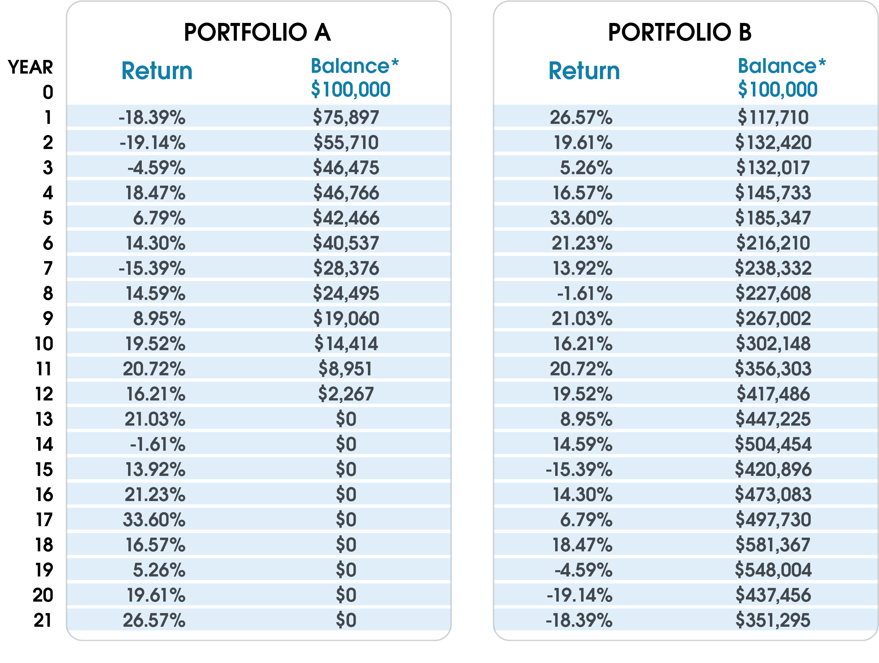
Sequence of Returns Risk
Starting balance = $100,000
Withdrawals = $7,000/year
In these charts, two hypothetical portfolios, A and B, each begin with $100,000. Each investor aims to withdrawal $7,000 per year and it is assumed that both portfolios experience exactly the same returns over a 21-year period, only in inverse order or “sequence”.

Slide 22
What is the number one cause of bankruptcy
in the USA?

Slide 23
Medical Expenses
​​​A study published in the American Journal of Public Health in 2019 found that 66.5% of bankruptcies in the U.S. were due to medical issues like being unable to pay high bills or due to time lost from work.*
Even with health insurance, high deductibles and copays, plus job loss, impact Americans.
*Source: Investopedia

Slide 24


Slide 25
How do I plan for Tax Efficiency in Legacy Planning?
Create a Gifting Strategy
  The annual gift exclusion for 2022 is $16,000. This means that each individual can gift up to this amount to any person without filing a gift tax return.
  In an ILIT (Irrevocable Life Insurance Trust) these gifts may go towards a life insurance premium, eventually Life Insurance policy goes tax-free to beneficiaries

Slide 26
How do I plan for Tax Efficiency in Legacy Planning?
  Consider a Roth IRA conversion
    Depending on your income tax bracket and overall financial situation, it could make sense to convert some or all traditional IRA assets to Roth IRAs. In the year the conversion takes place, the account owner will pay income taxes on the amount converted. As a result, the assets in the Roth IRA can grow tax-free and eventually be distributed tax-free to the beneficiaries, which can be a spouse, children, grandchildren, and others.
    Irrevocable Grantor Trusts: Selling appreciated assets to an Irrevocable Grantor Trust held for the benefit of heirs is another potentially attractive planning strategy in a low interest rate environment. Doing so removes the transferred assets (plus any future appreciation from your estate while retaining access to a certain level of cash flow.

Slide 27
LONGEVITY
LIFESTYLE
EXCESS WITHDRAWAL
INFLATION
ASSET ALLOCATION RISK
ARE YOU READY
FOR WHAT LIES AHEAD?
INCAPACITY
MEDICAL EXPENSES
MARKET RISK
EVENT RISK
TAX RISK
SEQUENCE OF RETURNS RISK

Slide 28
Name
Email
Phone
Website
LOGO
Thank you all
for attending

