Slide 1

Notes:
Welcome to today’s presentation: Wealth Management 101, where we’ll be showing you some of the wealth management strategies that may help build long-term wealth in today’s uncertain markets.

Slide 2
Notes:
Before we get started, we would like to go over a few housekeeping items. First of all, if you have cell phones, please silence them now. If your chairs are faced away from me, you may want to take a moment and reposition those chairs as well.
2

Slide 3
Notes:
Also, if you have any questions about what we are discussing today, please feel free to raise your hand and ask! Chances are if you’re wondering something, someone else in the room is wondering the same thing.
That being said, unless you are a client of ours, we know very little, if anything, about your situation. So, it would be irresponsible for us to say whether a specific investment is right for you and your goals. But if you have general questions, please feel free to ask, and we will be happy to answer them to the best of our ability.
3

Slide 4

INSERT YOUR DISCLOSURES HERE.
i.e. Securities and advisory services offered through BROKER DEALER, member FINRA, SIPC, and a Registered Investment Advisor.
DBA NAME and BROKER DEALER are separate companies.
BROKER DEALER does not provide tax or legal advice; consult your tax or legal advisor regarding your particular situation.
The indices mentioned in this seminar are unmanaged and not available for direct investment. Past performance is no guarantee of future results.
The economic forecasts set forth in this material may not develop as predicted and there can be no guarantee that strategies promoted will be successful.
Opinions, estimates, forecasts, and statements of financial market trends that are based on current market conditions constitute our judgment and are subject to change without notice. We believe the information contained in this commentary has been obtained from sources that are reliable. This presentation is for information purposes only and is not intended as an offer or solicitation with respect to the purchase or sale of any security.
These are the views of Marketing Pro, LLC and not necessarily those of the named representative, Broker dealer or Investment Advisor, and should not be construed as investment advice. Neither the named representative nor the named Broker dealer or Investment Advisor gives tax or legal advice. All information is believed to be from reliable sources; however, we make no representation as to its completeness or accuracy. Please consult your financial advisor for further information.
Notes:
Here are a few disclosures I’d like to bring to your attention so you may understand that there are risks to investing and nothing is guaranteed.
[Read the slide, then say:]
It should also be noted that there are no perfect investments. With every investment there are benefits and drawbacks; there are also fees involved. So, as I discuss certain investments today, I am by no means implying that there is a particular investment that is right for everyone.
At other seminars you may hear a pitch for a specific product or investment, but you won’t hear that today. We believe there are no “perfect” investments. This workshop is for informational purposes only. The factors we will be discussing are just some of the things we take into consideration when helping our clients.
4

Slide 5


Notes:
[Insert your compliance approved photo above.]
[Insert your compliance approved introduction/bio here.]
5

Slide 6
Notes:
Let’s take a look at our agenda for today. (READ SLIDE)
There are many factors that need to be considered when building your financial strategy. This presentation is designed to give you a good idea of some of the factors that need to be considered in your wealth management process.

Slide 7
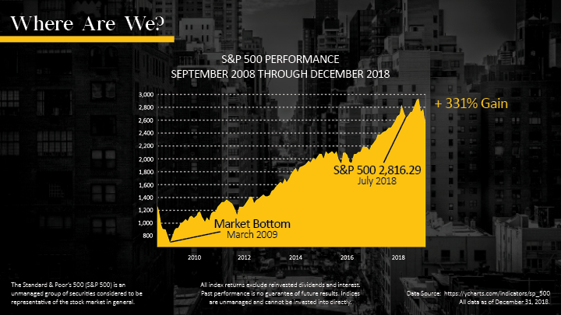
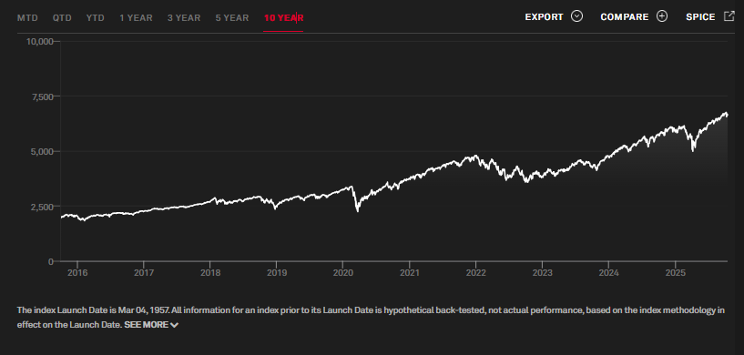
The Standard & Poor’s 500 (S&P 500) is an
Unmanaged group of securities considered to be
representative of the stock market in general.
All index returns exclude reinvested dividends and interest.
Past performance is no guarantee of future results. Indices
Are unmanaged and cannot be invested into directly.
Data Source: https://www.spglobal.com/spdji/en/indices/equity/sp-500/
As of October 17, 2025
Notes:
Let’s get started by taking a look at the Standard & Poor’s 500 index for the 10-year period ending December 31, 2018.
At first glance, some investors would say the S&P’s 500 appears to have gradually climbed over time. And we would agree with that assessment. However, lost in the 10-year trend can be the periods of market volatility characterized by declining stock prices.
For example, who remembers the 4th quarter 2018? Take a look at the chart. You can see the drop in the top, righthand corner. The 4th-quarter volatility can get lost in a long-term chart, but investors won’t soon forget the sudden, sharp decline in stock prices from October to December.
Sources: http://www.multpl.com/s-p-500-historical-prices/table/by-year
https://ycharts.com/indicators/sp_500 [5-16-2019]

Slide 8


Data Source:
https://www.bea.gov/data/gdp/gross-domestic-product
Notes:
The stock market is not the only thing we’re going to talk about today. The health of the economy as a whole also needs to be considered.
Let’s take a look at the Gross Domestic Product, or GDP. This chart shows the trend in GDP growth from January 2017 to the first quarter of 2019.
When you step back, it appears that the GDP has been trending higher since the second quarter 2018. So, what will the GDP show for the rest of 2019? That’s uncertain. But what I can tell you is that the Bureau of Economic Analysis (BEA) releases two estimates and one final figure for each quarter’s GDP. The BEA considers many economic reports when calculating the GDP, and those reports simply change over time.
The Bureau’s advanced estimate is based on the source data that is subject to further revision. The second estimate is based on more complete data. And the final figure becomes the official GDP for the quarter.
https://www.bea.gov/system/files/2019-04/gdp1q19_adv_0.pdf

Slide 9
Notes:
So, that’s a brief look at where we are now with the stock market and the economy. Let’s move forward and discuss some of the key challenges we face when building a wealth management strategy.
First, we’ll talk about inflation.

Slide 10

INFLATION CHECKLIST
Inflation and housing costs have increased.
SINGLE-FAMILY
HOME
A LOAF OF BREAD
COLLEGE EDUCATION
COST PER YEAR
1991
$97,000
$0.72
$5,452
2001
$147,800
$1.01
$9,032
2025
$433,500*
$1.84**
$31,009***
Sources:
*Single family home average cost July 2025 https://ycharts.com/indicators/us_median_price_for_existing_single_family_home
**White bread average cost August 2025 https://fred.stlouisfed.org/series/APU0000702111
***Cost for one year at 4-year public, out of state tuition (25/26 year) https://educationdata.org/average-cost-of-college-by-state
Notes:
I like to teach my clients about inflation by telling them that it’s possible their last car may cost more than their first house. (Ask for people to call out how much they spent on their very first house. They usually say $10-12,000 if you are speaking to a group of retirees.)
Let’s take a look at how inflation has impacted the prices of critical items over the past 28 years. Inflation is the rate at which the average price level of product or service in an economy increases over a period of time.
(READ SLIDE)
Many hope to experience an improved quality of life during retirement. The planned agenda for many retirees includes traveling, indulging in hobbies, and enjoying time with family.
However, some may forget to factor in rising prices. And that’s easy to do. The U.S. Bureau of Labor Statistics reported in April 2019 that inflation has been 2% for the prior 12 months. But with many Americans living 25 or 30 years in retirement, it’s absolutely critical to factor inflation into your financial strategies.
2018:
Single-family home: $376,000* (*average in March 2019)
A loaf of bread: $1.26
College education cost per year: $26,290* (*4-year, public, out-of-state tuition)
Sources:
https://www.census.gov/construction/nrs/pdf/uspricemon.pdf
https://www.bls.gov/regions/mid-atlantic/data/averageretailfoodandenergyprices_usandnortheast_table.htm
https://trends.collegeboard.org/college-pricing/figures-tables/average-published-undergraduate-charges-sector-2018-19

Slide 11
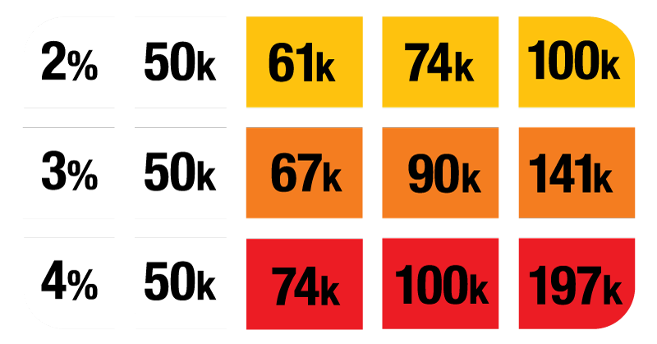
IF YOU NEED THIS MUCH AT RETIREMENT
… YOU’LL NEED ABOUT THIS MUCH
ANNUAL
INFLATION
CURRENT
INCOME
in 10 years
in 20 years
in 35 years
IN 10 YEARS
IN 20 YEARS
IN 35 YEARS
This example is for hypothetical purposes only.
It is not intended to portray past or future investment performance for any specific investment. Your own investment may perform better or worse than this example. This example does not include taxes or investment costs, which could have a dramatic effect on your results.
Sources:
https://www.usinflationcalculator.com/inflation/historical-inflation-rates
Notes:
Let’s take a look at the chart.
At 2% inflation, if you are currently living on $50,000 per year, in 10 years you will need $61,000; in 20 years, you will need $74,000; in 35 years, you will need $100,000. That’s what inflation does. Based on longevity, if you live 25, 30, or 35 years in retirement, and we see inflation do what it’s done here, will your portfolio keep up with inflation? Will your withdrawals keep up with inflation?
SOURCE: https://www.usinflationcalculator.com/inflation/historical-inflation-rates/
https://www.calculator.net/inflation-calculator.html?cstartingamount2=50000&cinrate2=3&cinyear2=10&calctype=2&x=86&y=19
https://tradingeconomics.com/united-states/inflation-cpi
11

Slide 12

• Manage Income Taxes
• Maximize Contributions
To Retirement Accounts
Qualified Plans (IRAs, TSA, 401(k)s, 403(b)s-
Plan distributions may be subject to tax and a
10-percent penalty if withdrawn before age 59½.
Notes:
We always like to emphasize that taxes are just one consideration in an overall financial strategy.
Any changes in strategy should be made in view of your long-term financial goals and in consultation with a tax advisor.
For illustration purposes, we always should assume the current tax rates will not change. If they do get adjusted, we would want to review how the new tax rates may influence your financial strategy.
For many people, if tax rates change, that may change your financial decisions regarding tax-deferred accounts and how to structure retirement withdrawals. In order to manage taxes, consider maximizing your contributions to tax-advantaged accounts, such as 401(k)s.
If you are still working and your employer offers a nonqualified deferred compensation plan (NQDC) – a popular option for executives – you may want to consider participating as a way to defer part of your compensation (and the income taxes on it).

Slide 13
CAPITAL GAINS & QUALIFIED DIVIDENDS
v
15%
20%
15%
20%
LONG-TERM
CAPITAL GAINS
QUALIFIED DIVIDEND INCOME
Sources:
https://investor.vanguard.com/investor-resources-education/taxes/dividends
Notes:
Capital gains taxes are another area that investors have to consider.
With respect to capital gains, taxpayers in the highest tax bracket are taxed at 20%, while those in the lower brackets pay either nothing or 15%.
The same tax rates apply to qualified dividends. Nonqualified dividends, which are often referred to as ordinary dividends, are taxed as regular income tax rates.
Just to remind you, to qualify for special capital gains tax treatment, a security must be held for at least a year. Also, not all dividends are qualified and must meet certain Internal Revenue Service criteria, which we won’t get into today.
Sources:
https://taxfoundation.org/2019-tax-brackets/

Slide 14

• Shift Taxable Investments
To Tax-Deferred Accounts
• Revisit Asset Allocation
Asset allocation is an approach to help manage investment risk. Asset allocation does not guarantee against investment loss.
Notes:
While you’ll definitely want to speak with a financial professional and tax professional before making any serious financial decisions, there are a couple things you may be able to do to reduce dividend and capital gains taxes.
One way to reduce investment-related taxes is to shift taxable assets to a tax-deferred account. We’re proponents of this approach because it not only allows investments in the account the opportunity for tax-deferred growth, but making contributions to these accounts can reduce your overall tax burden each year. This strategy is generally only possible for those who are still working, and annual contribution limits apply to retirement accounts.
Consider revisiting your asset allocation strategy by shifting your investments to assets that generate tax-exempt income, if that’s appropriate for your situation.
A prudent investment strategy is based on your investment goals, risk tolerance, and time horizon. As important as tax issues are, they should only be one factor you consider.
SOURCES:
https://money.usnews.com/investing/dividends/articles/2018-03-12/consider-the-tax-rate-on-your-investments
https://www.irs.gov/forms-pubs/about-publication-550
https://www.nerdwallet.com/blog/investing/tax-free-taxable-or-tax-deferred-accounts-where-should-your-investments-be/
(Accessed August 14, 2018)

Slide 15
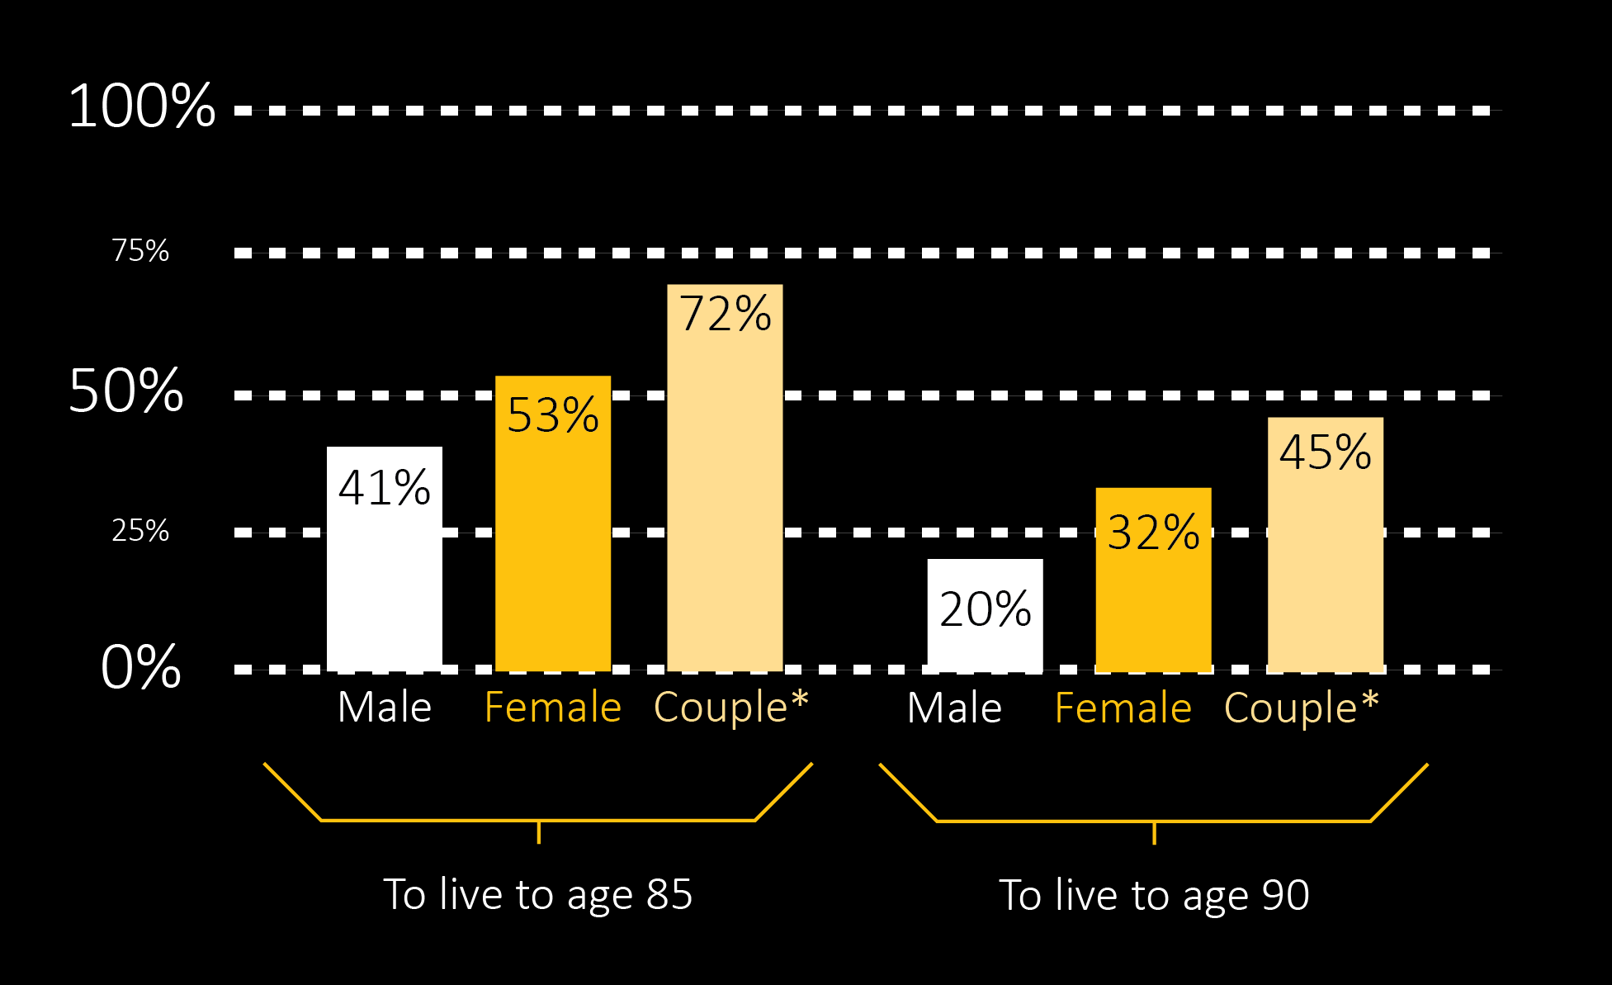
LONGEVITY
LIFE EXPECTANCY FROM AGE 65
Longevity data presented does not reflect mortality
from birth statistics available from US Census Bureau.
*Couples:
The chance that at least one of them will
live to any given age is increased.
Source:
CDC data captured from 2019
Notes:
One of the most important factors in preparing for a financially comfortable retirement is life expectancy.
Here’s the good news: Americans are living longer. Here’s some potential bad news: We’re living longer, and that creates a challenge for a retiree’s portfolio. This slide shows the probability of survival beyond age 65 for a couple. If you are a retired couple, both aged 65, the likelihood one of you will live 25 years in retirement is 45%. And there’s nearly a 20% chance that one of you could live to be 95 and spend 30 years in retirement. So, if you only plan for, say, 10, 15, or even 20 years, there’s a good chance you could come up short.
For this reason, it is especially important to use investment strategies that try to balance a sustainable withdrawal rate with the appropriate measure of risk. Balancing these factors is critical to help you create a strategy that’s designed to not run out of money before you run out of life.
Source: https://personal.vanguard.com/us/insights/retirement/plan-for-a-long-retirement-tool
(Accessed August 14, 2018)
15

Slide 16
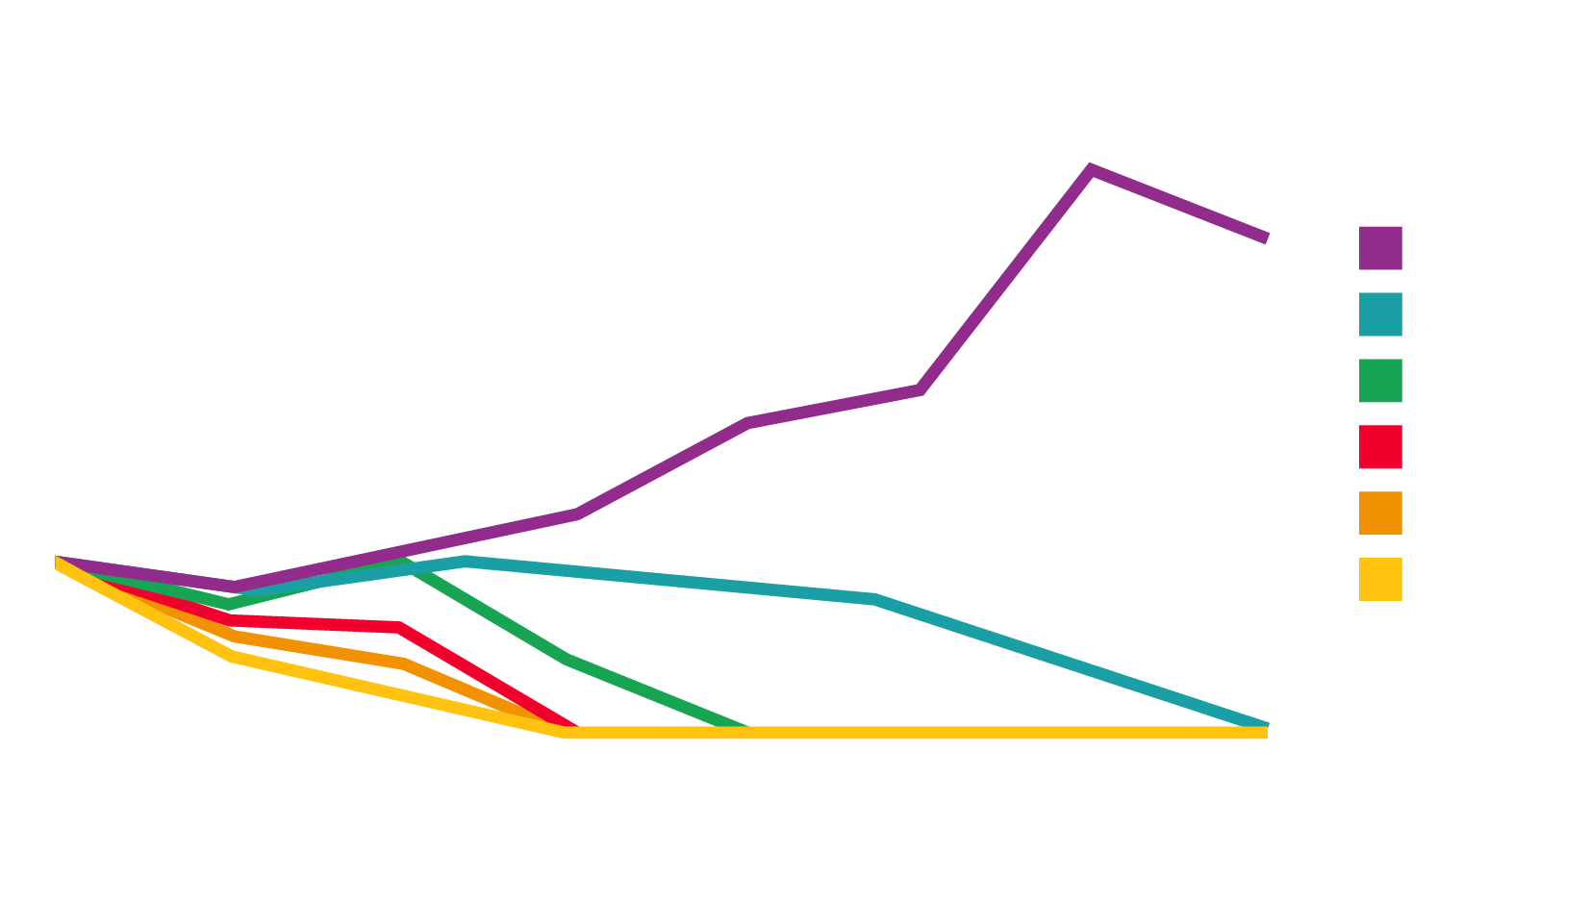
LONGEVITY
Hypothetical portfolio of an untaxed portfolio composed of 50 percent stocks, 40 percent bonds, and 10 percent Treasury Bills and the effect various inflation-adjusted withdrawal rates have on the end value of the portfolio over a long payout period. Each hypothetical portfolio has an initial starting value of $1,000,000. It is assumed that a person retires on January 1, 1970 & withdraws an inflation-adjusted percentage of the initial portfolio wealth ($1,000,000) each year.
Each monthly withdrawal is adjusted for inflation. Each portfolio is rebalanced monthly. Government bonds are guaranteed by the full faith & credit of the United States government as to the timely payment of principal and interest, while stocks are not guaranteed & have been more volatile than the other asset classes. Stocks in this example are represented by the Standard & Poor’s 500, which is an unmanaged group of securities & considered to be representative of the stock market in general. Bonds are represented by the five-year U.S. government bond, Treasury bills by the 30-day U.S. Treasury bill, and inflation by the consumer price index. An investment cannot be made directly in an index. Each monthly withdrawal is adjusted for inflation. Past performance is no guarantee of future results. Your portfolio may perform better or worse.
Various Withdrawal Rates
5,000,000
4,000,000
Dollars
Remaining
3,000,000
2,000,000
1,000,000
0
Age
Notes:
Longevity can drastically affect how you take money out of your retirement savings. To show how important this is, if you withdraw just 1% more than your planned withdrawal rate, you may not have enough money to continue this strategy before you die. It is a mathematical truth. This is why accuracy is so critical – because the razor-thin margin between 1% too much and getting it right could have a significant effect.
When I sit down with people, I typically ask them, “What withdrawal rate do you feel is sustainable?” And I usually get a variety of answers. On average I hear the rates of 5% or 6%. And they may be right, if they say “5%” and only live to age 95 as demonstrated above.
However, even looking at a portfolio that is 50% stocks, 40% bonds, and 10% Treasury bills, like the one shown here, notice the impact of just increasing the withdrawal rate by 1%, up to 6% – and another 1%, up to 7% – and another... Can you imagine what would happen if this portfolio were entirely in cash or fixed income? So, this shows that if somebody is too conservative, their likelihood of running out of money is significantly greater because their portfolio can’t keep up with their withdrawal rates. This is especially true when you add in the impact of inflation and longevity.
This is one of the key things we try to help our clients figure out, and it’s why we recommend working with a qualified professional.
16

Slide 17
Source: 2024 Genworth/CareScout Median Cost of Care
https://www.carescout.com/cost-of-care
Notes:
I know people may not like to talk about this, but another factor that should be considered when it comes to having a longer life expectancy is that long-term health care can get very expensive. While Medicare will cover many medical services, it may not cover these costs.
In 2017, [Read Slide]
Keep in mind that these numbers represent national averages. The costs each of us will face as we age will depend a lot on where we live and the kind of care we need. And we all know health care costs don’t seem to be going anywhere but up. Does your current financial strategy factor in the costs of extended care?
SOURCE: https://www.genworth.com/aging-and-you/finances/cost-of-care.html
(Accessed August 14, 2018)

Slide 18
Notes:
So, with just these four factors considered – and there are many more – it’s easy to see that effective wealth management involves more than just picking stocks. Some television commercials try to make you think it’s “so easy a baby can do it,” but there’s really a lot more involved in doing it right.
Let’s move on to the next section of our presentation. (READ SLIDE)

Slide 19


THE EMOTIONAL ROLLERCOASTER OF INVESTING
EUPHORIC
“I should quit my day job and do this full time!
Look at the money I’m making!”
POTENTIAL OPPORTUNITY TO MAKE MONEY
NERVOUS
“What happened?
What’s going on?”
CONFIDENT
“I’m making money.
This is great.”
HOPEFUL
DESPERATE
“Things seem like they’re turning around.”
“There’s no point in selling now; I’ve lost too much.”
RISKY
TIME
DEFEATED
“There go my dreams of
a comfortable retirement.”
This hypothetical scenario is for illustration purposes only and is not a prediction of future market conditions.
Notes:
One of the biggest challenges facing investors is the emotional rollercoaster of investing. Letting erratic, short-term movements of the markets create anxiety can push investors into making improper decisions. You can see here that investors go through a whole cycle of emotions depending on market movements. (READ SLIDE)

Slide 20
CHARTING A COURSE AND STICKING TO IT
PORTFOLIO IS DOWN (%)
TOTAL RETURN NEEDED TO BREAK EVEN
YEARS TO BREAK EVEN, ASSUMING A RETURN OF 3%
ASSUMING
A RETURN
OF 5%
ASSUMING
A RETURN
OF 8%
ASSUMING
A RETURN
OF 10%
ASSUMING
A RETURN
OF 12%
10
20
30
40
50
60
70
80
90
11
25
43
67
100
150
233
400
900
3.6
7.5
12.1
17.3
23.4
31
40.7
54.4
77.9
2.2
4.6
7.3
10.5
14.2
18.8
24.7
33
47.2
1.4
2.9
4.6
6.6
9.0
11.9
15.6
20.9
29.9
1.1
2.3
3.7
5.4
7.3
9.6
12.6
16.9
24.2
0.9
2
3.1
4.5
6.1
8.1
10.6
14.2
20.3
“This is a hypothetical example and is not representative of any specific situation. Your results will vary.
The hypothetical rates of return used do not reflect the deduction of fees and charges inherent to investing.”
Notes:
During times of volatility, investors may seek the safety of conservative investments or may even decide to get out of the market entirely. It’s perfectly natural to want to avoid losses and protect your assets. But abandoning your long-term investing approach in the face of short-term volatility can potentially slow your progress toward pursuing your goals and make the road to recovery longer.
This chart illustrates just how difficult it can be for a portfolio to recover after experiencing a downturn.
(READ CHART)
But of course, if you’re going to stick to a long-term investment strategy, it is vital that you incorporate some key principles.

Slide 21
Notes:
Nothing that we discuss in this section can guarantee success or protection in times of loss, but experience shows that these key principles can have a strong influence on your long-term financial health.

Slide 22

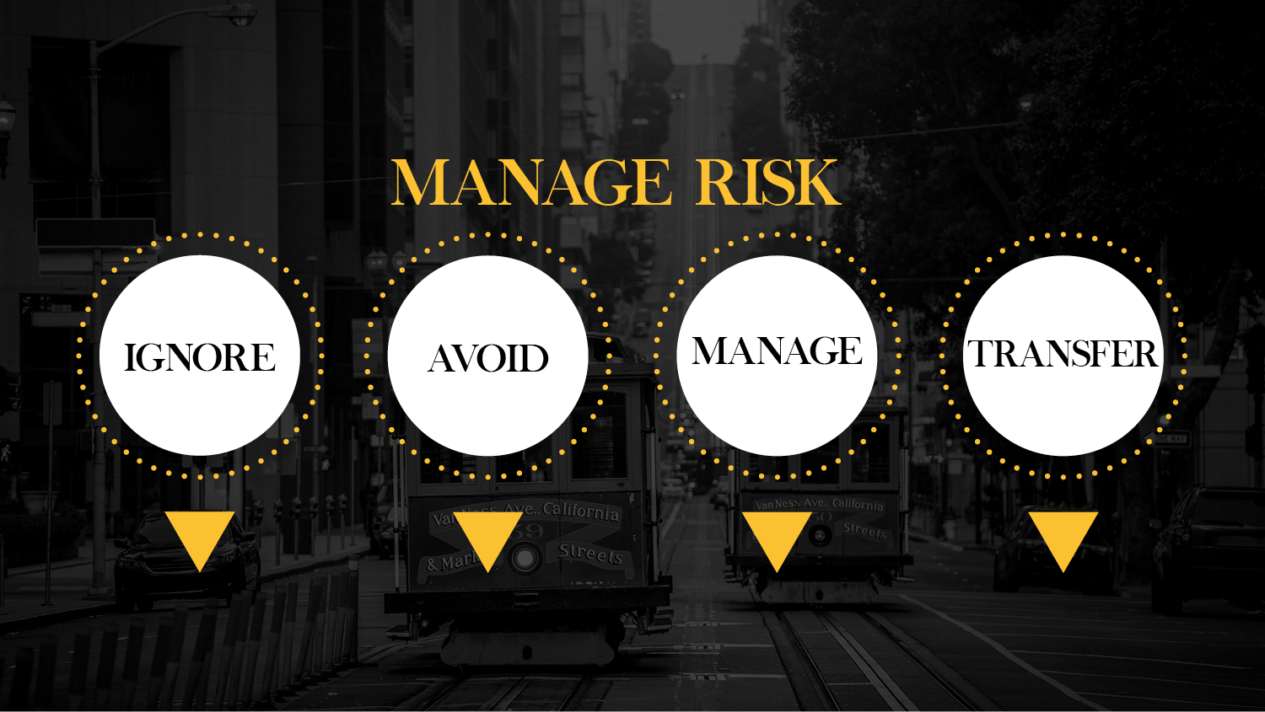
“If I crash, I’ll just buy a new car.”
“I won’t drive at all.”
“I’ll drive defensively with my hands
at 10 and 2.”
“I’ll buy car insurance.”
Notes:
Experience has taught us that there are four basic ways to address risk.
(READ SLIDE)
You might illustrate it this way. If you choose to drive a car, you have four choices related to managing the risk associated with that activity:
1) Ignore: “If I crash, I’ll just buy a new car.”
2) Avoid: “I won’t drive at all.”
3) Manage: “I’ll drive defensively with my hands at 10 and 2.” Despite your best efforts to do this, it still doesn’t mean you won’t get T-boned.
4) Transfer: “I’ll buy car insurance.”
When it comes to investing, deciding whether to ignore, avoid, manage, or transfer risk will vary from person to person. Our job is to educate you about your options and help you make the right decision.

Slide 23
INVEST FOR YOUR TOLERANCE
LOW
MEDIUM
HIGH
You have trouble dealing with any downturn and want consistent returns – even if they’re low.
Large performance swings may keep you up at night, but a moderate amount of fluctuation is okay with you.
Even large performance swings won’t derail your investment strategy. You’re as steady as a rock.
Notes:
It’s also critical for investors to take their own personal risk tolerance into consideration. This is why whenever we build portfolios for our clients, we always do an in-depth risk assessment with them.
(READ SLIDE)

Slide 24

SELECT SUITABLE INVESTMENT
Source:
Vanguard, The Global Case for Strategic Asset Allocation (Wallick et al., 2012).
Diversification does not ensure a profit or protect against a loss. Please remember that all investments involve some risk. Be aware that fluctuations in the financial markets and other factors may cause declines in the value of your account. There is no guarantee that any particular asset allocation or mix of funds will meet your investment objectives or provide you with a given level of income.
Notes:
Selecting a suitable combination of investments to meet your objectives is extremely important. Multiple studies have shown that asset allocation is the primary factor that influences volatility and return in a portfolio.
A 1991 study showed that asset allocation was responsible for more than 90 percent of a portfolio’s movement over time.
A similar 2012 study repeated those results, showing that 88 percent of portfolio performance over time could be attributed to the mixture of assets in the portfolio.
Bottom line: It’s not picking winners or jumping in and out of markets that determine long-term investment outcomes. It’s picking the right mix of investments for your personal situation.
Sources:
https://personal.vanguard.com/us/insights/investingtruths/investing-truth-about-risk
https://www.williamblairfunds.com/resources/docs/Fund-Literature/White-Papers/Determinants%20of%20Portfolio%20Performance%20II%20-%20An%20Update.pdf

Slide 25

Notes:
While we believe it is prudent to have a core of passive investment selections that are allocated for long-term growth potential, we also know that just because something is a good investment today, doesn‘t mean it will be a good investment tomorrow. This is why we choose to engage the human element – in the form of a single manager, co-managers, or a team of managers – when making investment decisions. Active managers rely on analytical research, forecasts, and their own judgment and experience in making investment decisions on what securities to buy, hold, and sell. While active management cannot eliminate risk of fluctuating prices and uncertain returns, nor can it ensure profit or guarantee against loss, both at our firm and at most of the investment companies where we place our clients’ assets, an active management strategy is frequently employed.
*Active management is when investment managers attempt to outperform the market by predicting market activity and can add value to portfolios by anticipating market cycles and continuously changing asset allocation over time. However, buying and selling securities can come at the cost of increased capital gains exposure.

Slide 26

PREPARE FOR THE UNEXPECTED
Notes:
Another key element related to wealth management involves being aware of what you have and taking steps to care for those you love in the event of your passing.
We often meet with prospective clients who are unaware of what they actually own, where it is located, or how to access it. That is one of the reasons we created this “Peace of Mind Checklist” to be a simple tool for organizing important financial documents. What we encourage you to do is complete this checklist and share it with those who may need to help you should an unexpected situation arise, such as the death of a spouse.
For all the married people in the room, we encourage you to complete this document for the benefit of your spouses. If something happens to you, you will likely want other close family members, your attorney, executor of your estate, and certain key figures to be able to access this information. If you are concerned about privacy, keep it locked in a fireproof safe. We have included one of these in each packet for your convenience.

Slide 27

Know Your Gifting Rights
Gift to Charity
Pass Assets to Heirs in the Most Tax-Efficient Way
Estate Strategy
Notes:
Another area we said we would touch on today relates to how you can leave a legacy for future generations.
This area of planning involves getting expert legal advice in addition to working with a qualified financial professional. To that end, we maintain integral relationships with local attorneys and CPAs who assist us and our clients in order to ensure everything works as efficiently and effectively as possible.
For example: Rather than just leaving each of your loved ones with a lump sum of money, you can specify when they receive access to that money, how they can use it, and even what tax consequences they face. Of course, to do all this successfully requires putting forth the effort to plan in advance. This is another area involved in effective wealth management.

Slide 28

Diversification is an approach to help manage investment risk. It does not eliminate the risk of loss if security prices decline.
Asset allocation also is an approach to help manage investment risk. Asset allocation also does not guarantee against investment loss.
Notes:
Total wealth management doesn’t leave out any pieces. As we go about managing the wealth of our clients, there are many strategies we employ.
(READ SLIDE)
Additionally, we are not advocating any of these strategies to anyone here today. The strategies we use for you personally may be very different from the strategies we use for the person sitting next to you, based on a number of important factors. So, please remember that we are sharing this with you strictly for informational purposes. Investing involves risk, which includes the potential loss of principal. No investment strategy can guarantee a profit or protect against a loss in periods of declining value.

Slide 29
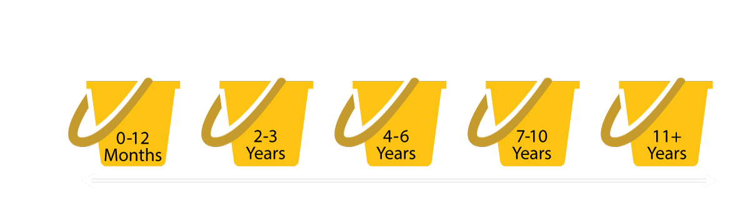
STRUCTURE BY DESIGN
Conservative/Liquid
Risky/Illiquid
This hypothetical scenario is for illustration purposes only and is not a prediction of future market conditions.
Notes:
We strongly believe that everyone’s investment needs are unique, and we work hard to structure a custom portfolio for each client.
To illustrate how we do this, imagine a portfolio that has five buckets.
Bucket No. 1 contains the money we put away for the income needs for your family for the next 12 months.
Bucket No. 2 contains the income that you will need for years two and three.
Bucket No. 3 is the income that you are going to need for years four, five, and six.
Bucket No. 4 represents the income that you will need for years seven to 10.
Bucket No. 5 contains the money that you will need 11 years, plus.
Now do you think we should be managing the money that you will need for the next 12 months the exact same way as the money you will need for 11 years, plus?
Absolutely not.
So, as previously stated, the first bucket contains the money that we put away for the first 12 months.
The second, the money you need for years two to three, or in the third, for years four, five, and six, you can start becoming a bit less conservative.
How about the money you will need from seven to 10 years? Do you think we could start to take on a little more risk with that?
And where is the risky part of the portfolio? The aggressive part? Naturally, that would go in bucket 5, the money that you don’t need for 11 years, plus.
So, basically, what we are doing is assessing both your short-, medium-, and long-term needs as well as spreading the money into different instruments with the proper amount of risk and liquidity. In this way, we strive to ensure that you are prepared for various future phases of life.

Slide 30
“Planning is bringing the future into the present so that you can do something about it now.”
— Alan Lakein
Notes:
(READ SLIDE)
Both the challenges and the strategies we have discussed today can be very difficult to balance properly. And as we have highlighted, just taking one misstep can make the difference between enjoying a prosperous retirement and winding up broke. Please let us help you protect what you have worked so hard to earn.

Slide 31

• Help you diversify across asset classes and set realistic expectations for performance
• Communicate with you regularly
and educate you about factors that
could affect your financial future
• Encourage you to think long term, tune out the noise, and avoid knee-jerk reactions
• Monitor your portfolio and
recommend changes over time
Notes:
In summary, what are we doing to help our clients work through all the factors we’ve shared in this presentation?
(READ SLIDE)
If you are a visitor here today and you do not currently have a financial representative, or if your financial representative is not providing services like this for you, we would be more than happy to provide you with an obligation-free, complimentary assessment of your portfolio. Even if you are content with your current holdings, it may be wise to get a second opinion. Much like you would visit a doctor for a second opinion before making an important medical decision, your financial health deserves special attention as well.

Slide 32

PLEASE COMPLETE
Notes:
So, now, if you will, please take out the sheet where you fill out your name and address, find the box at the bottom, and check the area where you can request a complimentary financial review.
Our services are not right for everyone, and we are selective about the clients we work with to ensure that we are a good fit for them. I would like everyone to entertain the offer of having the review. During this review, we will take a look at your present holdings and make this determination: Are you on track for your present goals?
If you are doing this on your own, what will happen to your spouse if something happens to you? Do they understand the difference between stocks and bonds and how they relate to a well-balanced portfolio? If not, maybe getting a second opinion would benefit you.
I make this promise to you: If after taking a look at your present portfolio, we agree with what you are presently doing, we’ll tell you that. However, if we see areas in need of improvement, then we will tell you what those are and give you our recommendations on how you could be doing things differently.
32

Slide 33

Notes:
This concludes today’s presentation. We hope that you enjoyed the information we shared, and we’ll be around to answer your questions.

